Slide 1
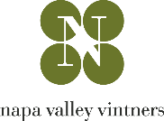

NAPA VALLEY CABERNET SAUVIGNON:
A GLOBAL PERSPECTIVE
Peter Marks MW

Slide 2

CABERNET SAUVIGNON
A GLOBAL PERSPECTIVE
Notes:
Welcome to the Napa Valley Vintners’ Ambassador Program!

Slide 3
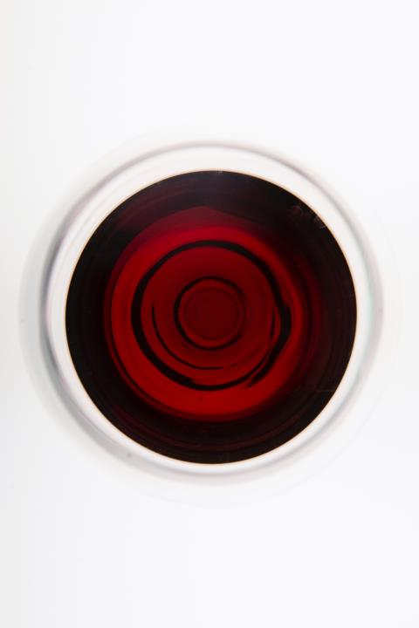
LEARNING OBJECTIVES
DESCRIBE the style of Napa Valley Cabernet Sauvignon and the main influences that lead to its style, quality and price.
DESCRIBE key style features of other top Cabernet Sauvignon wines of the world and the main influences that lead to their styles, with the ability to compare these styles to Napa Valley Cabernet Sauvignon.
Notes:
Following this session you will walk away with an understanding of how Napa Valley Cabernet Sauvignon fits into the world of top cabernet sauvignons. This webinar looks into key influences causing the various styles so that members can feel confident comparing styles of Cabernet Sauvignon and discussing how Napa Valley differentiates itself on the world stage.

Slide 4

Cabernet Sauvignon Overview
Napa Valley Style & Influences
Key Styles & Influences Of Other Regions
Program Outline
Notes:
We’ll do a brief overview of Cabernet Sauvignon the grape
Then look at Napa Valley’s CS’s style and how climate, soil and winemaking influences its style
And finally, we’ll spend most of today diving into other major CS regions around the world, comparing and contrasting with Napa Valley
Let’s go!

Slide 5
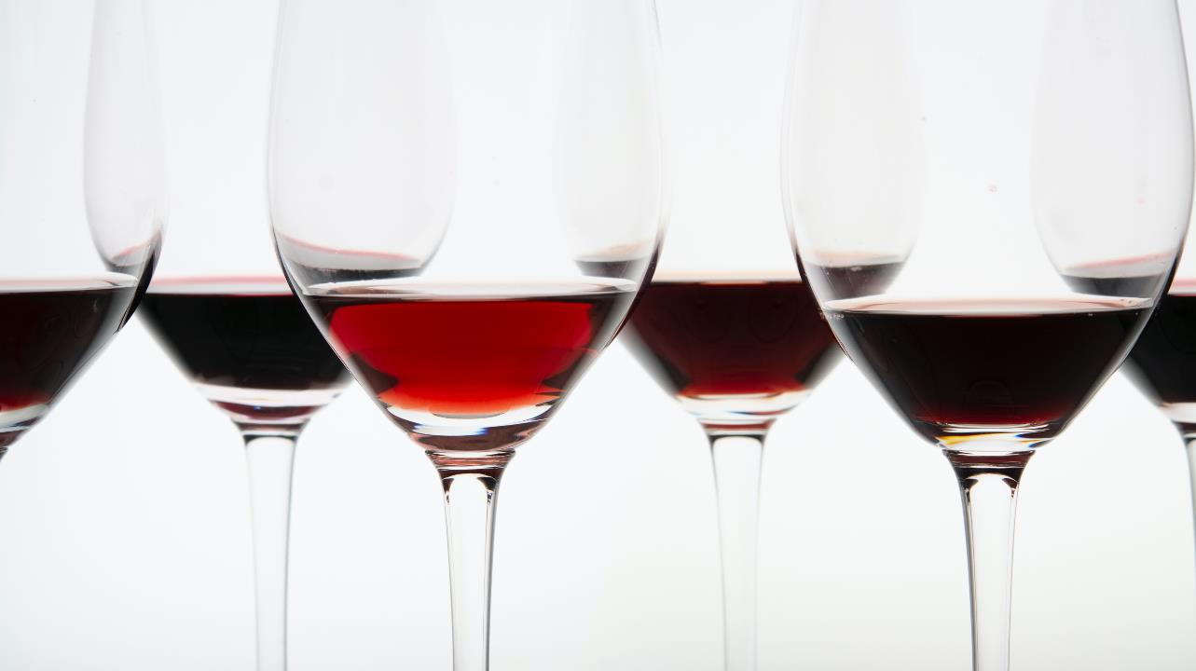
CABERNET SAUVIGNON
It’s all in the Family
Notes:
CS Originated in the Gironde in Southwest France (Bordeaux), earliest mentions are under the name Petit Cabernet in 1760s and 1770s.
Sauvignon comes from the French word sauvage meaning wild, and Cabernet Sauvignon got its name from the fact that its wood and leaves resembled those of sauvignon blanc that has an appearance similar to wild grapevines
Cabernet Sauvignon is the most important, most planted and most expensive grape variety in The Napa Valley and truly the lifeblood of farming, winemaking, tourism and our economy.

Slide 6
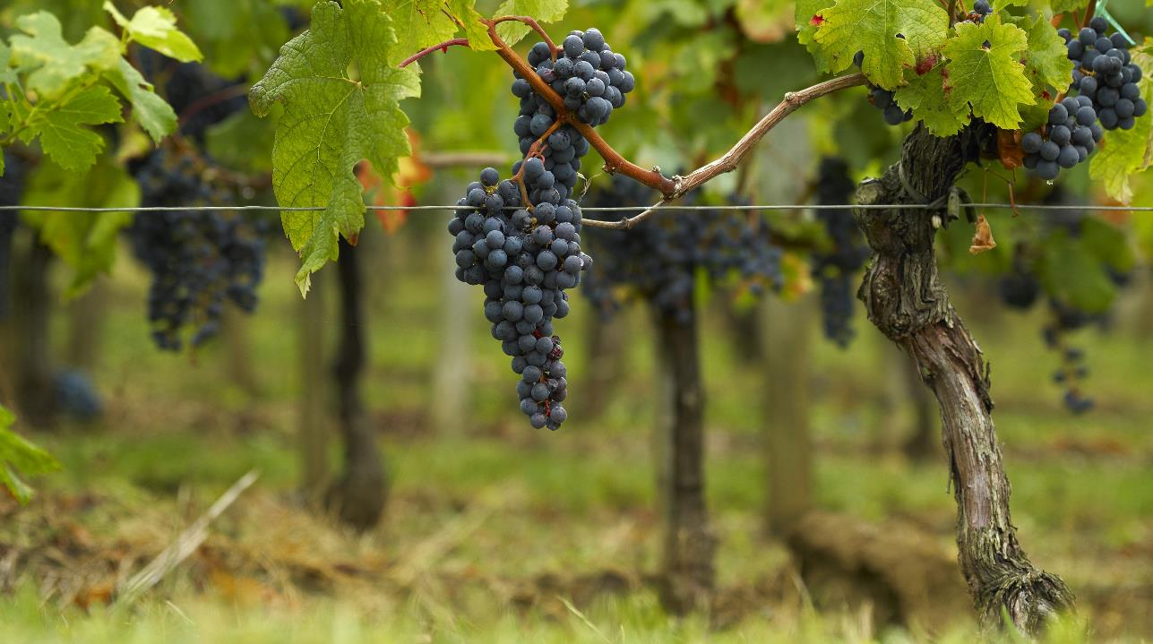
HISTORY
Parentage
Heritage
Reputation
Sauvignon Blanc & Cabernet Franc
Bordeaux
International variety
5% of worlds vineyards
Notes:
Cabernet Sauvignon’s origins for long remained shrouded in mystery but all was revealed in 1996, thanks to dna profiling by our own Carole Meredith (Lagier-Meredith) of UC Davis and her research assistant John Bowers determined it was a cross of Cab Franc and Sauv Blanc. Most likely this was a natural occurrence in the vineyard and this neatly explains why Cabernet Sauvignon can smell like either or both of its parents
Its homeland in the Bordeaux, France and it’s also grown in many warm regions of California, including Sonoma County, Paso Robles and the Central Valley, but it is truly king in Napa Valley. It is also grown around the world, as we’ll see
Cabernet is the world’s most renowned red wine grape and the most cultivated grape variety, planted in almost every country that produces wine, representing 5% of the total world area under vines. As such, it is known as an “international variety”.

Slide 7
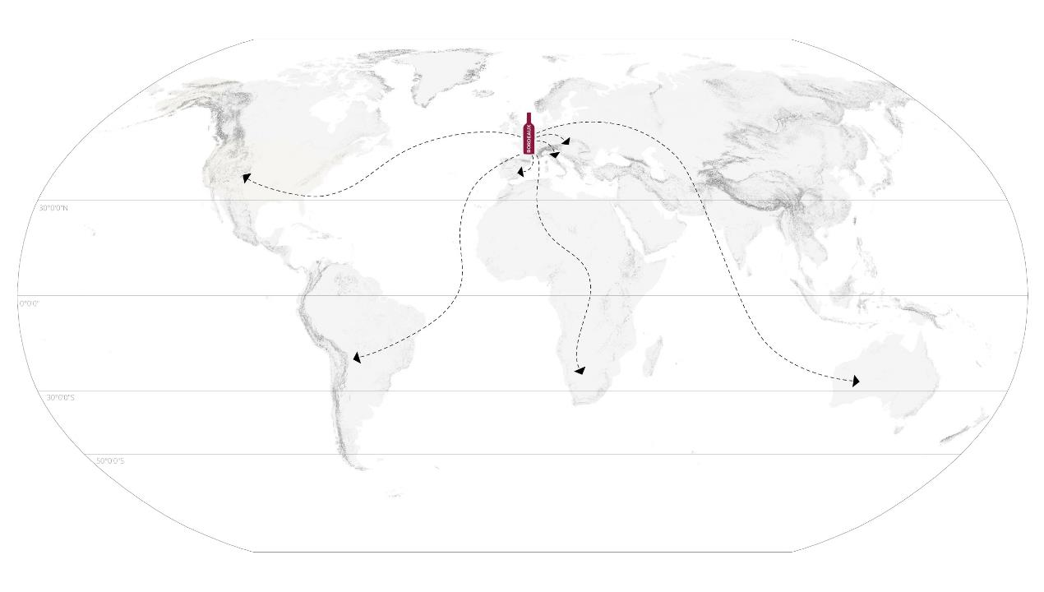
CS’ TRAVELS
CS TRAVELS
Notes:
From its homeland and power base in Bordeaux, where it is almost always blended with other grapes, it was then planted in other French wine regions and also taken into much of the Old and New World growing regions.
In many regions it is blended to create Bordeaux blends and often with indigenous varieties.
In warmer climates, and many parts of the New World, it’s produced as pure varietal wine and labeled as such.

Slide 8
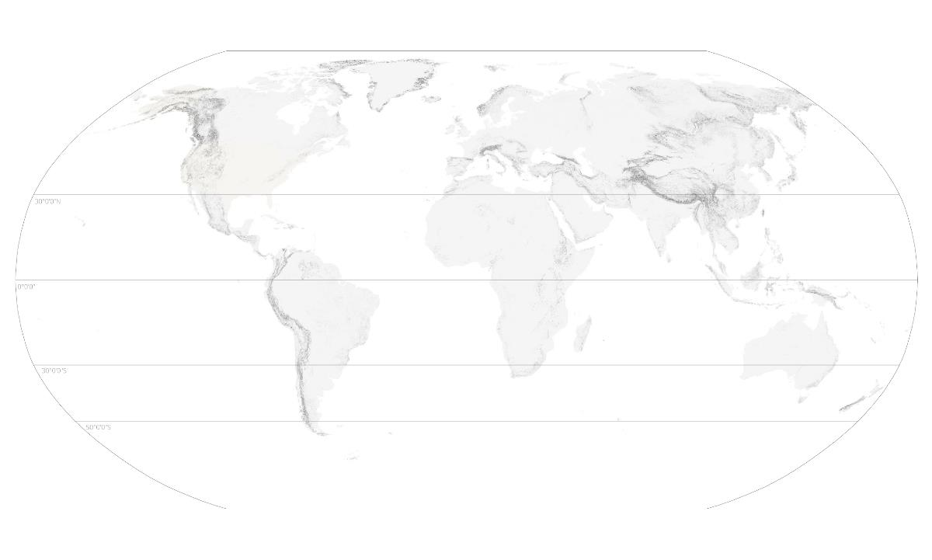
CABERNET IN THE WORLD
Italy
Washington
Bordeaux
California
Chile
Argentina
South Africa
Australia
New Zealand
Notes:
The main areas we’ll cover today are indicated on this map in red, plus we’ll give an honorable mention to South Africa and New Zealand.
We should mention that CS is grown in many places all over the world to great acclaim including Canada, Bulgaria, Hungary, Ukraine, Lebanon, New York, Texas and production is growing quickly in China.

Slide 9
TOP QUALITY EXPRESSIONS
Italy
Washington
Bordeaux
TUSCANY
California
NAPA
SONOMA
PASO ROBLES
Chile
MAIPO
Argentina
Australia
MENDOZA
COONWARRA
MARGARET RIVER
Notes:
Specifically, here are the regains we’ll look at today. They comprise areas that are reliably producing top-quality expressions of this grape.
Perhaps the most extraordinary aspect of Cabernet Sauvignon is its ability to produce a wine that is so recognizably Cabernet and the ability to be enjoyed young as well as after aging a number of years.

Slide 10
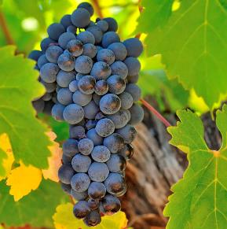
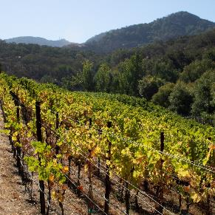
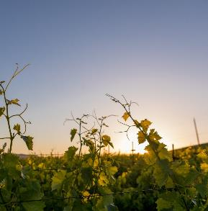
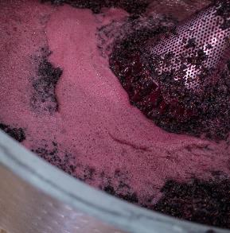
CABERNET CHARACTER
GRAPE
CLIMATE
VINEYARD
CELLAR
Notes:
Let’s look at the characteristics of Cabernet, the type of climate it prefers, how it performs in the vineyard and techniques used in the winery.

Slide 11
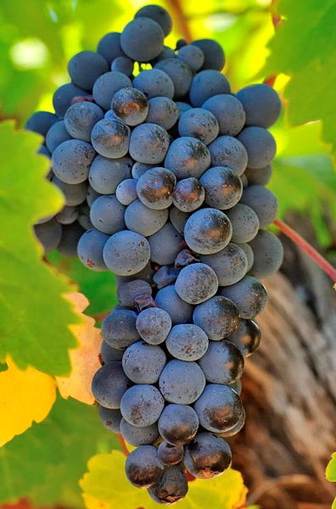
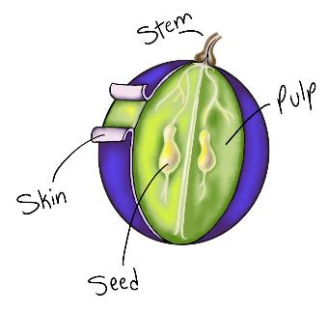
Small berry size
Thick skins: high phenolics
Deep color: high tannins
High ratio: seed to pulp
High acidity
the grape
© 2020 Napa Valley Vintners and Napa Valley Wine Academy
Notes:
The distinguishing marks of the Cabernet Sauvignon berry are its small size, its high ratio of seed to pulp and the thickness of its skins, which are distinctively blue, on the vine.
This large seed to pulp ratio are a major factor in Cabernet Sauvignon’s high tannin level while the thickness of its skins accounts for the depth of color as well as the high tannin.
Cabernet Sauvignon ripens slowly so is ideally suited to the Mediterranean climate of Napa, however this can prove an issue in cooler coastal regions.
Cabernet Sauvignon that fails to reach full ripeness can taste eerily like its parent, Cabernet Franc, with green pepper notes

Slide 12
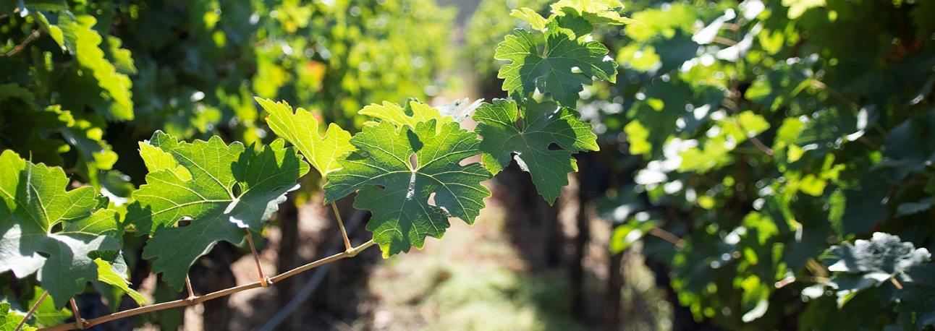



CABERNET SAUVIGNON IN THE VINEYARD
BUDDING
CLUSTER
RIPENING
VIGOR
EARLY
LATE
SMALL
LARGE
EARLY
LATE
LOW
HIGH
Notes:
Late budding (advantage in areas with Spring frost risk)
Bunches and berries are small
Mid to late ripening (so needs a long growing season, which Napa Valley enjoys) ripens 1-2 weeks after Merlot and Cab Franc
Vigorous but not exuberant. Often grafted onto a weak rootstock to maintain its vigor,

Slide 13
CABERNET CHARACTER
COLOR
TANNIN
BODY
CABERNET SAUVIGNON
© 2019 Napa Valley Vintners and Napa Valley Wine Academy
© 2019 Napa Valley Vintners and Napa Valley Wine Academy
Notes:
The characteristics of Cabernet Sauvignon, like most grapes, can vary by climate, region and winemaking, but in general you can expect to experience:
As a thick-skinned grape, Cabernet delivers plenty of deep, opaque ruby color
Small grapes and thick skins provide for high levels of phenolics: deep color, high tannins. The phenolics provide the structure for age-ability of the wines.
It is known for being full-bodied, bold and powerful
But is balanced by its juicy, high acidity

Slide 14
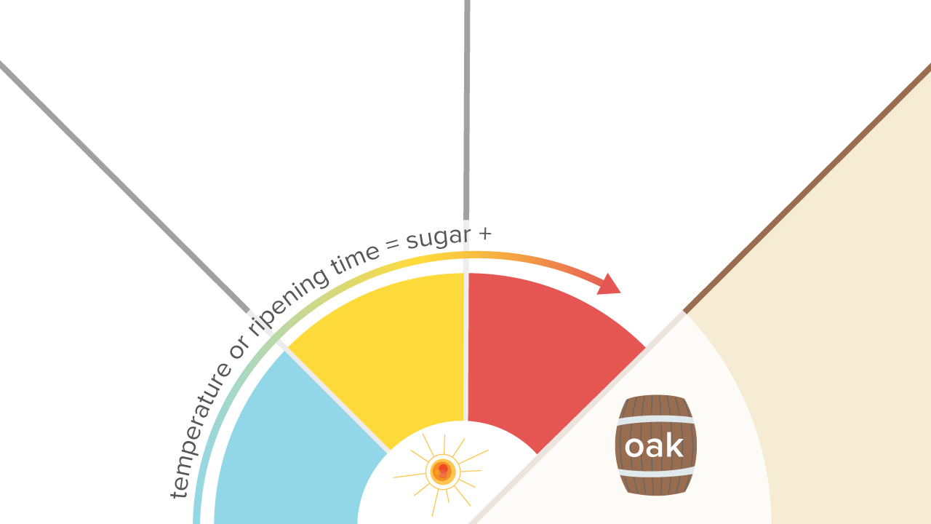
FLAVOR
-ripe black currant
-black cherry
-herbal
-jammy black berry
-rich cassis
-ripe black cherry
-green bell pepper
-black currant leaf
-red & blackcurrant
-baking spices
-vanilla toast
© 2019 Napa Valley Vintners and Napa Valley Wine Academy
Notes:
You’ll most often find flavors of black fruit with herbal/floral notes and pungent spice
Under-ripe cabernet sauvignon can take on green (bell pepper) aromas and flavors.
In moderate to warm climates, CS develops flavors of black currant, black cherry and herbal notes.
And, In very warm climates, CS showcases concentrate flavors of ripe blackberry fruit with black currant, black cherry and jammy notes
As with Merlot, oak aging will also impart warm notes of baking spice, vanilla and toast
Baking spice, vanilla, toast

Slide 15
THE VINEYARD
Notes:
Cabernet Sauvignon ripens slowly so is ideally suited to the Mediterranean climate of Napa, however this can prove an issue in cooler coastal regions.
Canopy management is important, especially in cooler sites, where heavy shading of the bunches could result from the vine’s high vigor.
Its slow ripening means that the timing of harvest is less critical than with more fussy grapes such as Syrah and Zinfandel.
It thrives on well-drained gravel soils, which is found extensively in Napa Valley in the alluvial fans at the base of the mountains.
Its hard wood makes it suitable for mechanical harvesting and makes it generally protected from the risk of winter freeze.

Slide 16
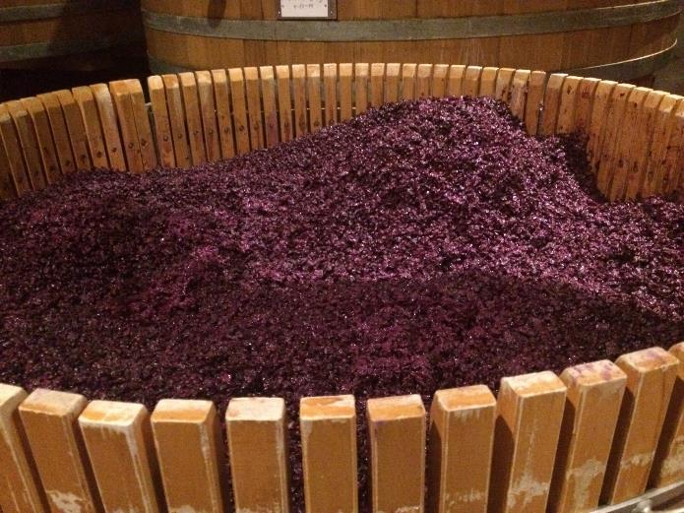
WINEMAKING INFLUENCE
Notes:
Cabernet has such a distinctive character with its aromas and flavors that even when grown at high yields and made with little to no exposure to oak, it still leaves a recognizable imprint in the wine.
That said, the winemaker can have a large impact on the wine’s ultimate style especially when blending in other varieties.

Slide 17
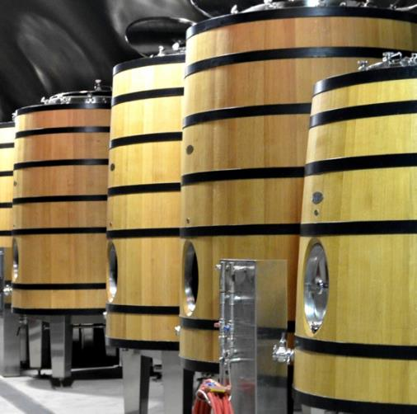
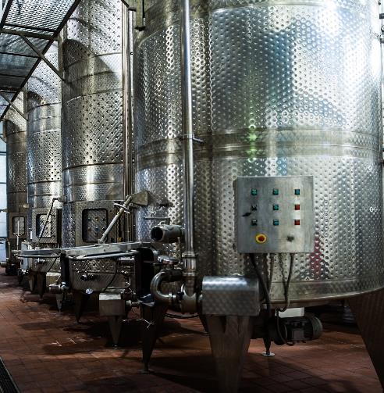
FERMENTATION
Neutral vessels
Oak casks
Notes:
Cabernet Sauvignon and Merlot are made in very similar ways.
Cold soaking may be used to extract color and flavors from the skins, but not tannin because this is only extracted more easily in the presence of alcohol
Vessels are typically temperature-controlled SS tanks or large, neutral oak tanks.
Some believe oak vessels are better in retaining the wine’s temperature after fermentation, resulting in further polymerization of the tannins and a softer mouthfeel in the wine
In any case, fermentation temperatures below 90F is generally ideal

Slide 18
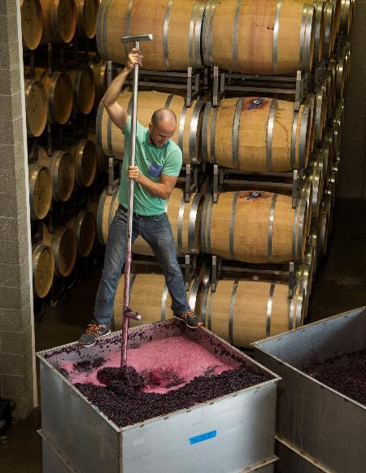
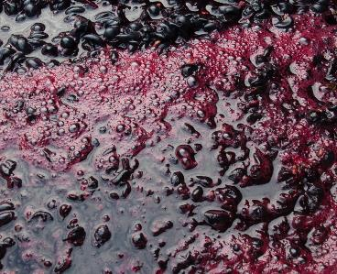
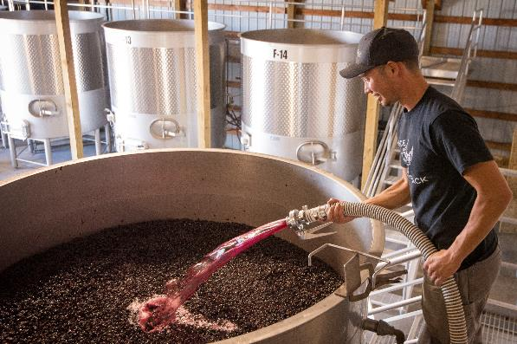
EXTRACTION
Pump Over
Punch Down
Notes:
Important to extract color, flavors and tannins from the skins.
Pump Over
Punch Down
Rack & Return – drain completely – separated from the solids - then returned to the vat where the solids are to re-soak. This is usually repeated daily. (Delestage)
Rotary Fermentation

Slide 19
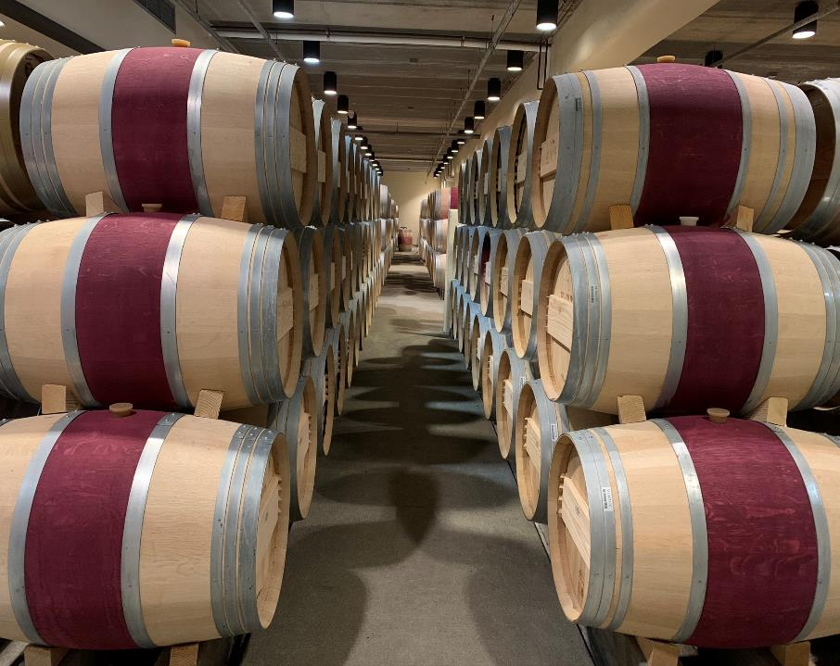
AGING
Notes:
Premium Cabernet Sauvignon is almost always aged in oak barrels for 12 to 24 months, allowing the tannins to soften and incorporating even layers of toasty, spice notes if new oak is used.
It is not unusual to find 100% Cabernet Sauvignon wines, but it is often blended with other Bordeaux Varietals, especially Merlot, CF, PV as they compliment each other so well.
Cabernet’s girth and structure are balanced by Merlots soft, suppleness.

Slide 20


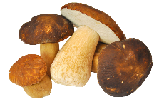
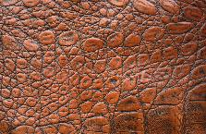
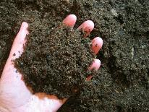
MATURITY
Cigar Box
Tobacco
Mushrooms
Leather
Earth
Forest Floor
© 2019 Napa Valley Vintners and Napa Valley Wine Academy
Notes:
Tertiary compounds such as these usually begin to form around 5 to 6 years of age
Plus, this is when tannin polymerization will also begin to appear, thus you might start to see some sediment, although at 10 years or older this is more likely to occur, resulting in a more complex and softer wine.

Slide 21
A GLOBAL PERSPECTIVE

Slide 22
MAP
UNITED STATES
© 2020 Napa Valley Vintners and Napa Valley Wine Academy
Notes:
If you missed our Napa Valley presentation a few weeks, this will serve as a brief overview

Slide 23
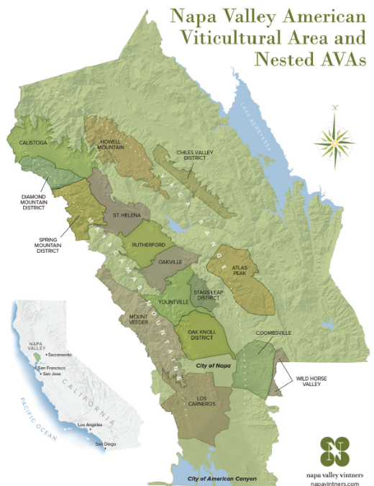
MAP
Napa Valley
Between Mayacamas and Vaca Mountains
30 miles long, 5 miles wide
16 Nested AVAs
Known for exceptional wines
© 2020 Napa Valley Vintners and Napa Valley Wine Academy
Notes:
The valley is formed by the Mayacamas Mountains to the west, which mark the border with Sonoma County, and the Vaca Mountains on the east.
30 miles long, 5 miles wide
½ the size of Sonoma
1/6 the size of Bordeaux
Like most of the north–south valleys around San Francisco Bay, it’s generally cooler in the south and warmer in the north.
Napa’s consistently exceptional wines are due to its magnificent diversity of exposure, climate, and soil, which has led to 16 nested-AVAs within the main AVA.
Not too dissimilar to the divided communes of Bordeaux as we’ll see later.
The main valley has little more land to plant, some opportunities to expand do exist in the smaller valleys in the hills to the east, and it’s very difficult nowadays to plant on hillsides or anywhere with more than 5% slope
Today, Cabernet Sauvignon is the best-selling red wine in the US and by far the most widely planted wine grape in the Napa Valley at approximately 50% of all vines in the region.
Approximately 4% of California’s vineyard acreage at 46,000 acres

Slide 24
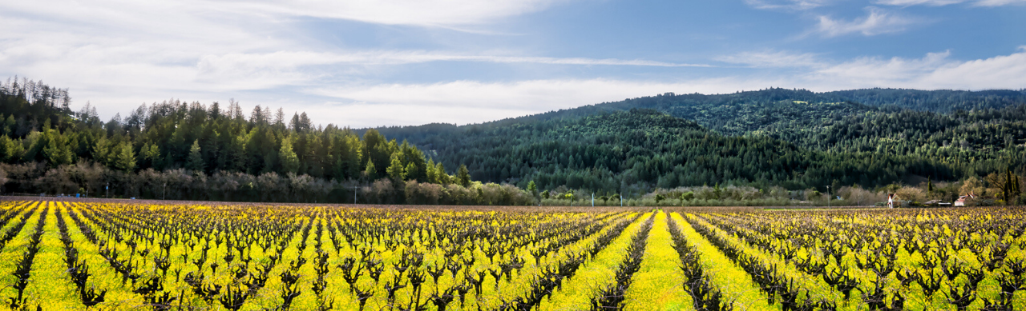
HISTORY
Napa Valley
The Early Years
A Turning Point
Modern History
George Calvert Yount plants 1st commercial grapes
Europeans arrive
Prohibition decimates Napa
Andre Tchelistcheff arrives
Napa Valley Vintners
Robert Mondavi builds winery
Ag Preserve
1976 Judgement of Paris
Napa Valley becomes an AVA
100 Pt. Groth CS Reserve
Cult Cabs take hold
Notes:
1838-39: George Calvert Yount plants the first commercial vineyards in the valley
1860s and ‘70s: Europeans like Jacob Schram, Charles Krug, and Jacob Beringer arrived in Napa
1879: Gustave Niebaum establishes Inglenook, first chateau-style winery in US
Late 1800s: Napa booms, 140 wineries in 1889, until phylloxera hits:
1920: Prohibition lasts for 13 years; many vineyards planted over to plums and walnuts. At the end only 100 acres of vineyards of CS in CA.
1938: Andre Tchelistcheff arrives at Beaulieu Vineyards
1944: NVV formed when 7 vintners signed an agreement to work together to solve industry problems
1966: Robert Mondavi builds his eponymous winery
1968: Community passed the country’s first Agriculture Preserve to prevent future over-development of the valley.
1976: Judgement of Paris
1981: Napa Valley becomes AVA
1985 Groth CS Reserve became first American wine to receive 100 points from Robert Parker. He made his name with 1982 Bordeaux, so his word was gospel.
California cult wine – a phrase coined in the early 90’s to encompass great growths made in the State of California, typically but not exclusively were Napa Valley Cabernets
For which collectors, and some investors, would pay prices higher than those of Bordeaux’s first growths. Typically, cult wines are made in extremely limited quantity, by a talented winemaker consultant.
Producers like Araujo, Bryant Family, Colgin, Harlan, Screaming Eagle, Sine Qua Non to name a few.

Slide 25
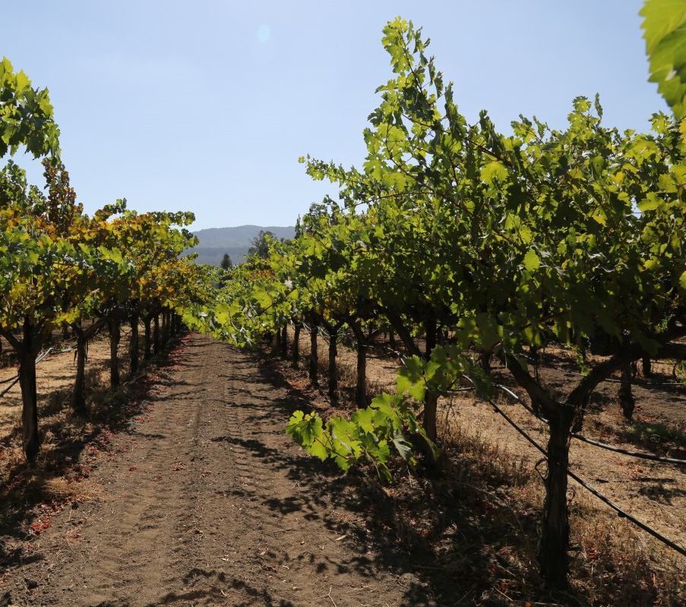
QUIZ
Napa Valley
Approximately what percent of Napa Valley’s vineyards are planted to Cabernet Sauvignon?
30%
40%
50%
60%
© 2020 Napa Valley Vintners and Napa Valley Wine Academy

Slide 26
QUIZ
Napa Valley
Approximately what percent of Napa Valley’s vineyards are planted to Cabernet Sauvignon?
30%
40%
50%
60%
© 2020 Napa Valley Vintners and Napa Valley Wine Academy

Slide 27
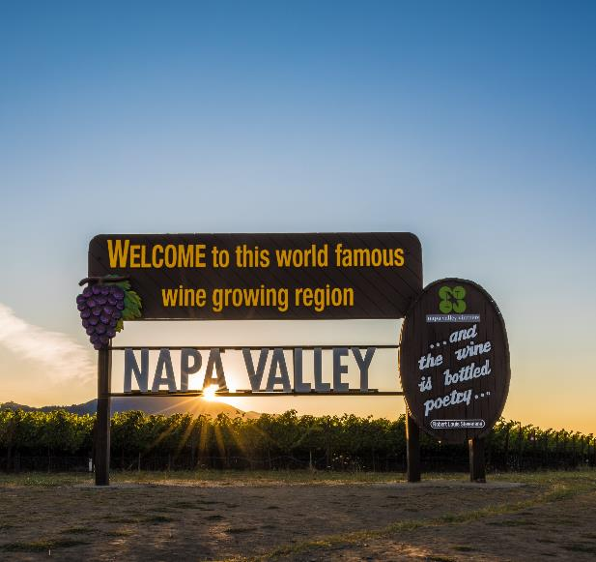
FAST FACTS
Napa Valley
NV makes 4% of California’s wine
NV Cabernet Sauvignon makes up:
  51.9% of Napa’s production
  70% of Napa’s crop value
  19.5% of CA’s crop value
CS averages $8,000/ton
  2X more than Merlot,
  Nearly 3X more than PN
© 2020 Napa Valley Vintners and Napa Valley Wine Academy
Notes:
Napa is only 4% of California wine, yet it accounts for 30% of economic value.
NV Cabernet Sauvignon makes up:
51.9% of Napa’s production
70% of Napa’s crop value
Nearly 20% CA’s crop value
Napa’s quality is reflected in its grape prices.
Value of a ton of Napa Valley Cabernet Sauvignon grapes was nearly 6 times the statewide average.
Average price per ton of NV CS is $7,941 (2019)
24,354 acres; 22,504 bearing

Slide 28
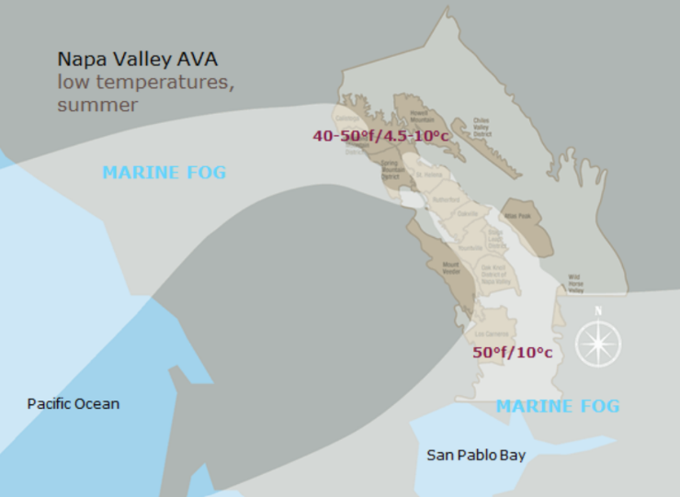
CLIMATE
Napa Valley
Mediterranean Climate
Oakville & Rutherford in the sweet spot
Vintage to vintage consistency
© 2020 Napa Valley Vintners and Napa Valley Wine Academy
Notes:
Napa Valley is located within the rare Mediterranean climate zone, which encompasses just 2% of the earth’s surface.
Our climate is typified by warm, dry summers; mild, low humidity and wet winters
Well-balanced wines due to long growing season
Low humidity reduces risk of disease, mold/rot
Long, slow growing season aided by:
Cool air & fog from San Pablo Bay & Mountain gaps
Wide diurnal swings maintains acidity and freshness
Vintage to vintage consistency

Slide 29
SOIL
Napa Valley
© 2020 Napa Valley Vintners and Napa Valley Wine Academy
Notes:
As we said, Cabernet Sauvignon is the most widely planted grape variety in Napa Valley and it no wonder why.
We have various bedrock materials but it’s primarily volcanic and marine sediment formed millions of years ago.
Valley floor in the middle of the valley where you typically encounter fluvial soils
Silts and clays deposited along riverbank;
More fertile, retain more water; Easier to dry farm; Vigor must be curtailed
CS are rounded, with more supple tannins compared to alluvial fans and Mountain vineyards
Alluvial fans are benchland vineyards on gentle slopes rising up the hills as you see here
Soils are deep, rocky, moderately fertile, and well-drained
The Benchlands tend to be less fertile than fluvial soils, but more fertile than the hillsides, producing broader and more powerful wines packed with ripe black fruit and silky tannins.
The Rutherford Bench and Oakville Bench are famous examples
Mountain vineyards, on the other hand, have thinner, less fertile soils
Small, intensely flavored berries with structured tannins and complex aromatics
They are highly prized for their concentration.
Each of the mountain ranges: the Mayacamas to the west and Vacas to the east, reaches approximately 2,500 feet above the valley floor.
This provides different climatic influences

Slide 30
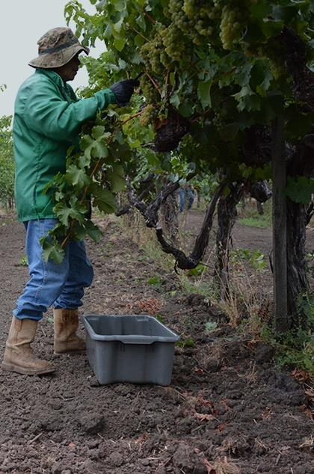
GRAPEGROWING
Napa Valley
Napa Green certification
UC Davis is important resource
Time tested farming meets latest technology
Best vineyard practices produce highest quality
© 2020 Napa Valley Vintners and Napa Valley Wine Academy
Notes:
In 2015, the Napa Valley Vintners established the goal that all its eligible members will be in the Napa Green environmental certification program by the end of 2020 – Green Vineyard and Winery
As of 2019, NVV is 70% of the way towards achieving this goal
UC Davis is important resource
40-acre Oakville Station research vineyard
Time tested farming meets latest technology
Experiments with Clones, rootstocks, vine spacing, pruning levels, irrigation
NASA satellite vineyard mapping
Drones
Just to name a few

Slide 31
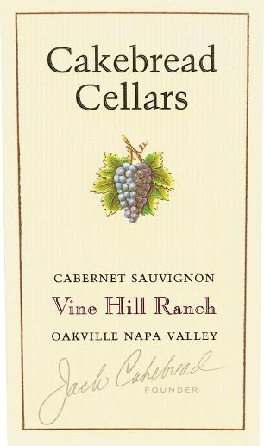
PRODUCTION RULES/LABEL LAWS
Napa Valley
TTB rules, with some exceptions
  75% grape variety
  State = 100%
  County = 75%
  AVA = 85%
  Vineyard = 95%
Labels MUST say Napa Valley if also labeled with a nested AVA - 1990
Notes:
Conjunctive labelling in 1990
Awareness of Napa Valley AND the nested AVA
The AVA system was launched in 1980 by the US government under the branch of the Alcohol and Tobacco Tax and Trade Bureau, aka TTB, in order to recognize specific regions for growing wine grapes.
It might surprise you to know that Napa Valley was not the first official AVA in the US. It was Augusta MO
Rules, with some exceptions
75% grape variety
State = 100%
County = 75%
AVA = 85%
Vineyard = 95%

Slide 32
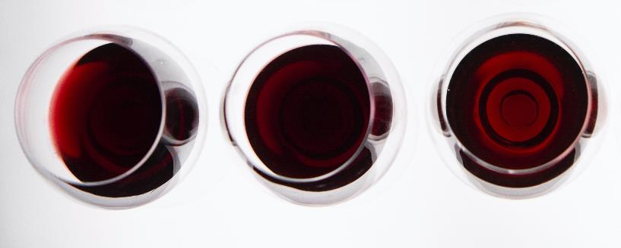
STYLE
Napa Valley
Napa Valley Cabernet Sauvignon
Deeply colored; high, fine-grained tannins; bright acidity; full-bodied
Generous use of new oak – baking spices and toast
Powerful, rich, blackberry, black cherry, ripe plum
Great aging potential
Single varietal or blended
Valley vs. mountainside sourcing
© 2020 Napa Valley Vintners and Napa Valley Wine Academy
Notes:
Deep/opaque color; high tannins; relatively high bright acidity.
Distinctive aromas and flavors that transcend its vineyard location, no matter where it is planted
Pronounced aromas and flavors that range from black fruits to some herbal/floral (violet) and pungent spice.
Less-ripe cabernet sauvignon can take on green (bell pepper) aromas and flavors.
It is not unusual to find 100% Cabernet Sauvignon wines in Napa Valley, but it is often blended with Bordeaux Varietals, as they compliment each other so well.
Valley rounder tannins vs. mountains more formidable tannic structure

Slide 33
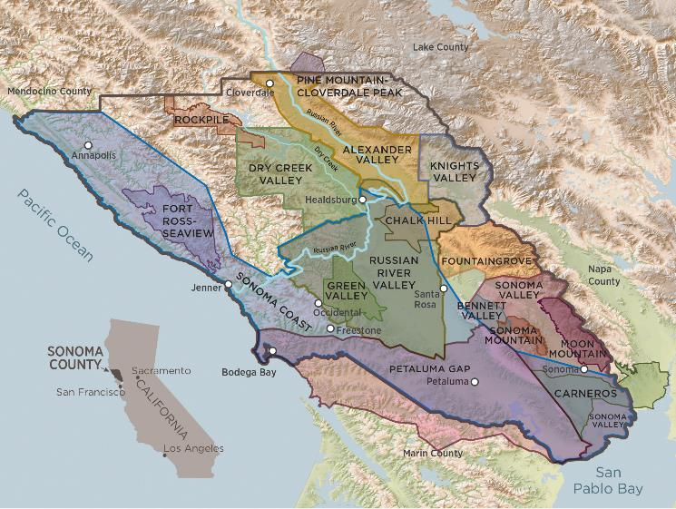
MAP
Sonoma County
Wide range of microclimates
17 AVAs
60+ grape varieties
85% family-owned
Alexander Valley & Knights Valley known for Cabernet Sauvignon
Map and data sourced from sonomawine.com & sonomacounty.com
© 2020 Napa Valley Vintners and Napa Valley Wine Academy
Notes:
Sonoma Co. has a wide range of microclimates and growing conditions across its 17 unique nested AVAs – 18 if you include Northern Sonoma (Chalk Hill, Knights Valley, Alexander Valley, Dry Creek Valley, Russian River Valley and part of Rockpile & Pine Mountain-Cloverdale Peak.
60+ grapes compared to 35+ in Napa
85% family owned – Napa is 95% family owned

Slide 34
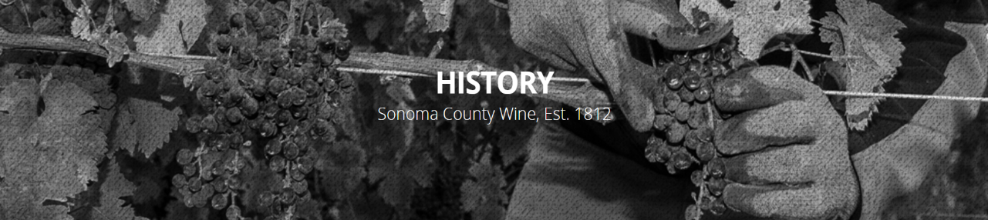
HISTORY
Sonoma County
1800s
Early to mid-1900s
Later 1900s
Russian Colonists and Missionaries
1857 - Agoston Haraszathy “The Father of California’s Wine Industry”
Phylloxera
Prohibition stops thriving industry
Americans develop taste for wine
André Tchelistcheff consulted on CS
½ of Ch. Montelena ’s winning Chardonnay came from Sonoma
Beringer, Louis Martini and others sourced CS grapes from Sonoma Co.
Photo from https://sonomawine.com/learn/history/
© 2020 Napa Valley Vintners and Napa Valley Wine Academy
Notes:
1812 Russian Colonists planted grapes at Fort Ross (Sonoma Coast.) followed by Spanish missionaries in the town of Sonoma in 1823
1857 The Hungarian Count Agoston Haraszthy “The Father of California Wine Industry” founded Buena Vista winery in Sonoma Valley. Brought many vinifera vines
1873 Worldwide outbreak of phylloxera destroys vineyards.
1920 There were 256 wineries. With more than 22,000 acres (8,900 ha) in production, Sonoma County had surpassed Los Angeles.
1920 – 1933 By the time Prohibition is repealed, Less than 50 wineries in Sonoma County survive.
1933 - 1945
1960’s Americans developed a taste for wine and demand began to grow.
1970 A second generation of wineries are started, following a nationwide wine boom. Consumption grows at a 40% rate.
Andre T consults with Simi, Jordan, Buena Vista.
1976 No doubt few knew that 20 tons (nearly half) of the chardonnay fruit for the Chateau Montelena chardonnay came from Sonoma County vineyards JOP. Bacigalupi Vineyards (14 acres)
1980’s Sonoma County made the transition from being known as a producer dairy, grain and fruit crops with grapes in fourth position.
By 1989 grapes were Sonoma County’s top revenue-generating agricultural crop.
Today, icons of the industry like Beringer and Louis Martini were sourcing Cabernet Sauvignon grapes from Sonoma County vineyards.

Slide 35
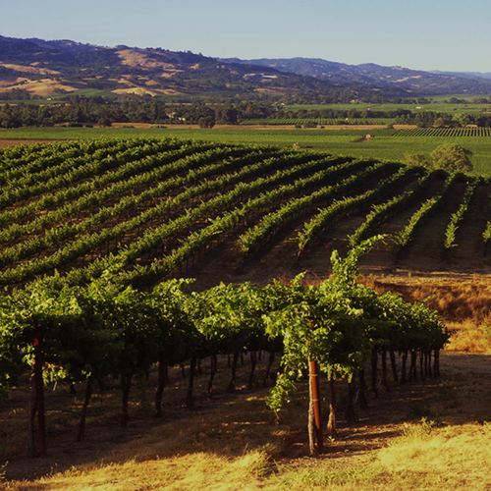
FAST FACTS
Sonoma County
6% of California’s wine productions
12,628 acres of Cabernet Sauvignon
  21% of plantings
Knights Valley & Alexander Valley
  Referred to as the “Napa Valley of Sonoma County”
© 2020 Napa Valley Vintners and Napa Valley Wine Academy
Notes:
Despite proximity to Napa County AVA these two neighbors are distinctly different. Sonoma County AVA is more than double the size of Napa County, with 60,000 acres dedicated to winegrowing, as compared to Napa’s 45,000.
Cabernet sauvignon is planted on some 12,628 acres of Sonoma County vineyard land, and claims only slightly less acreage than Pinot Noir
Cabernet sauvignon represents 21% of the county’s total vineyard acreage and ~30% of the county’s total red wine grape acreage.
Popular in warmer appellation such as Knights Valley, Alexander Valley, Dry Creek Valley and Sonoma Valley
The largest and most planted of Sonoma’s AVAs for CS is Alexander Valley. This warm AVA, along with Knights Valley, could be referred to as the Napa Valley of Sonoma County.
Their sheltered inland positions and the gravelly soils combined with the warm climate produce powerful cabernet.
The majority of plantings are on the valley floor although some producers are now creeping into the hillside vineyards in search of better quality, more balance, freshness and nuanced complexity.

Slide 36
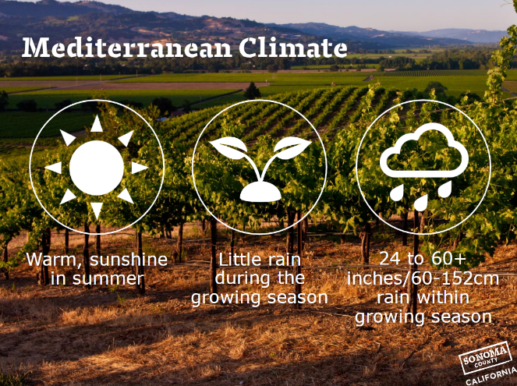
CLIMATE
Sonoma County
More rain than Napa
Fog and ocean breezes from Pacific Ocean
More climate variation than Napa
Vintage variation
Picture courtesy of sonomawine.com
© 2020 Napa Valley Vintners and Napa Valley Wine Academy
Notes:
Sonoma’s weather patterns are shaped by the cool Pacific Ocean which runs along 60 miles of the region
Being closer to the ocean with fewer mountains to protect, winter rains are heavier (48” Healdsburg, 38” Santa Rosa, 37” St. Helena, 27” Napa)
Even in the warmest appellations, during summer the Pacific pushes cooling fogs and ocean breezes into the regions many valleys cooling temperatures to 40F or 50F at night, preserving the grapes acidity and balance
These many valleys crisscross the region, running both north to south and east to west.
This, along with Sonoma’s size and the impact of the cool Pacific Ocean, creates an array of climates.
This means that Sonoma vintages can vary and that a great year for Pinot noir and Chardonnay may not be great for Cabernet and Zinfandel.
The Alexander Valley is cooled from south to north by marine air moving in from the Pacific Ocean via the Petaluma wind gap and the Russian River valley. The combination of enough heat to ripen the crop but a big enough cool down to preserve freshness and acidity are keys to wine quality.

Slide 37
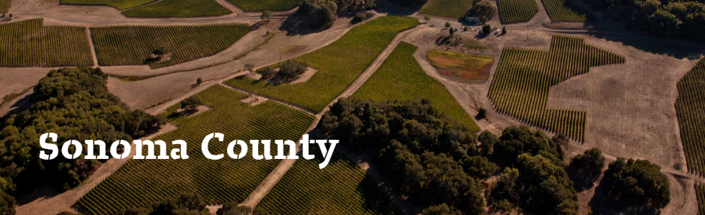
SOIL
Historic geological events led to wide soil variations
Soil fertility varies from valley floor, to benchlands, to high elevations
Alexander Valley and Knights Valley
  Volcanic, river gravel and ocean mixture
Picture courtesy of sonomawine.com
© 2020 Napa Valley Vintners and Napa Valley Wine Academy
Notes:
Historic geological events led to wide soil variations resulting in 11 major soil formations, 31 soil series with variations within each series (Napa has 12 soil orders and 33 different soil series)
As we find in Napa Valley, soil fertility varies from valley floors, to well-drained alluvial benchlands and finally rising up to the mountains on the west side of the Mayacamas.
Alexander & Knights Valley - Tend to a mixture of volcanic, ancient seabed and river gravel deposits from the Russian River.

Slide 38
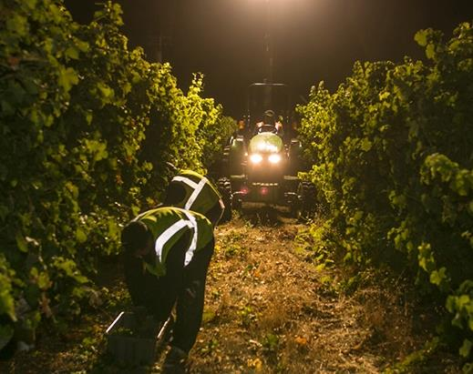
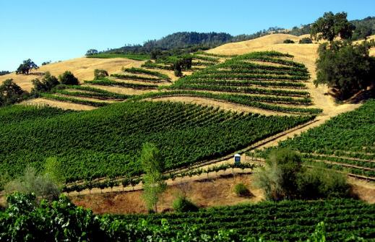
GRAPEGROWING
Sonoma County
Alexander Valley AVA
  Higher elevations cause thicker skins
  Matures 2 weeks later than valley floor
Knights Valleys AVA
  Most remote AVA
© 2020 Napa Valley Vintners and Napa Valley Wine Academy
Notes:
The largest and most planted of Sonoma’s AVAs is Alexander Valley. The warmest valley in the AVA, along with Knights Valley
Their sheltered inland positions and the gravelly soils combined with the warm climate produce powerful cabernet.
Elevations in Alex Valley range from 400 to 2500 feet. Stronger UV light causes thicker skins that add color, flavor, and structure.
Higher elevation vineyards receive slightly more sunshine because the fog line burns off sooner—but their stressed soil conditions, and slightly cooler temperatures extends the maturation up to two weeks later than the benchlands and valley floor
80% of the Alexander Valley vineyard parcels are grown in the valley’s benchlands
This is found in Knights Valley too.
It’s the most remote AVA on the foothills of Mt. St. Helena featuring many benchland and mountain vineyards
Weathering, erosion, gravity, and water movement have further moved and settled things into a hodgepodge of soils that require testing and experience to match the right variety, rootstock, amendments and irrigation schemes to each site.

Slide 39
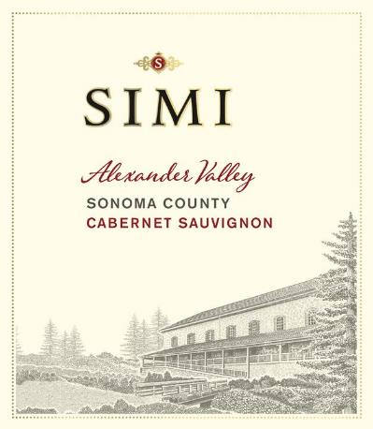
PRODUCTION Rules/Label Laws
Sonoma County
TTB rules, with some exceptions
  Grape variety = 75%
  State = 100%
  County = 75%
  AVA = 85%
  Vineyard = 95%
Labels MUST say Sonoma County if also labeled with a nested AVA entirely within Sonoma County - 2010
Notes:
Conjunctive labeling passed in 2010 for any wines after 2014 – 20 years after Napa instituted this legislation
The AVA system was launched in 1980 by the US government under the branch of the Alcohol and Tobacco Tax and Trade Bureau, aka TTB, in order to recognize specific regions for growing wine grapes.
It might surprise you to know that Napa Valley was not the first official AVA in the US. It was Augusta MO
Rules, with some exceptions
75% grape variety
State = 100%
County = 75%
AVA = 85%
Vineyard = 95%

Slide 40
STYLE
Sonoma County
Napa Valley Cabernet Sauvignon
Deeply colored; high, fine-grained tannins; bright acidity; full-bodied
Generous use of new oak – baking spices and toast
Powerful, rich, blackberry, black cherry, ripe plum
Great aging potential
Single varietal or blended
Valley vs. mountainside sourcing
Sonoma County Cabernet Sauvignon
Like Napa - black fruit, concentration, firm structure
Less use of new oak, very approachable when young
Leaner, more herbaceous than Napa Valley
Alexander Valley Cabernet Sauvignon
  Blackberry aroma, supple tannins, broad flavors
Knights Valley Cabernet Sauvignon
  Powerful, fleshy with nuanced complexity
© 2020 Napa Valley Vintners and Napa Valley Wine Academy
Notes:
As in Napa, cabernet sauvignon is celebrated for its black-fruited concentration and tannic structure. Sonoma Cabernet is often more approachable when young than its Napa counterpart – and often less expensive.
Sonoma CS can be fleshy and voluptuous displaying distinct chocolatey warmth though in a leaner style and often with a hint of herbaceousness as compared to Napa.
Alexander valley - intense blackberry aroma and layers of tannin, giving broad flavors and supple tannins to the wine’s palate and contributing to a long elegant finish. All things being equal, AV will be a bit softer and will likely show more herbaceous character compared to Napa.
Knights Valley - Powerful, fleshy with nuanced complexity, especially if coming from hillsides – you might say they are between a SLD CS and a Howell Mt. CS.
Finally, many experts believe CS of Napa tend to show a longer aging potential than Sonoma, although this has never been proven. Maybe a good project for a MW research paper.
That may be due to growers and winemakers taking greater care in making the wines since the price of Napa Valley CS allows them to do so.
Or it may be related to the fact the yields for CS are lower in Napa than in Sonoma (3.6 tons/acre vs. 3.8)

Slide 41
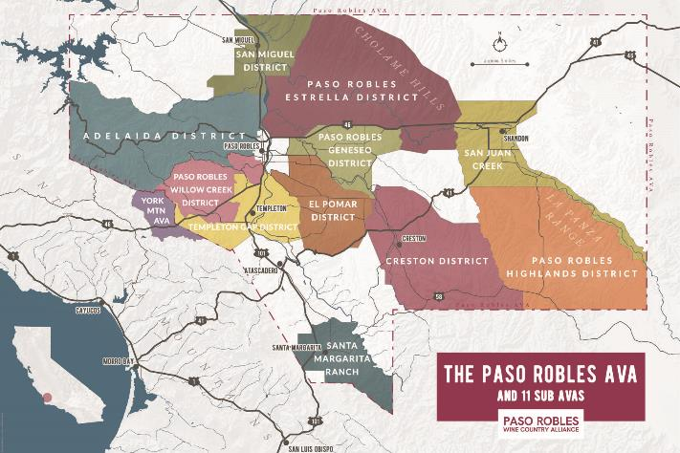
MAP
Paso Robles
Almost 3X larger than Napa
Santa Lucia Mountains to the west
Cholame Hills to the east
11 nested AVAs
Map courtesy of pasowine.com
© 2020 Napa Valley Vintners and Napa Valley Wine Academy
Notes:
Center of the Central Coast AVA – between Monterey and Santa Barbara counties
Napa is 1/3 the size of Paso Robles
Santa Lucia Mountains to the west
Cholame Hills to the east
Paso Robles was the largest un-subdivided AVA in CA until 2014 when 11 nested AVAs were approved

Slide 42
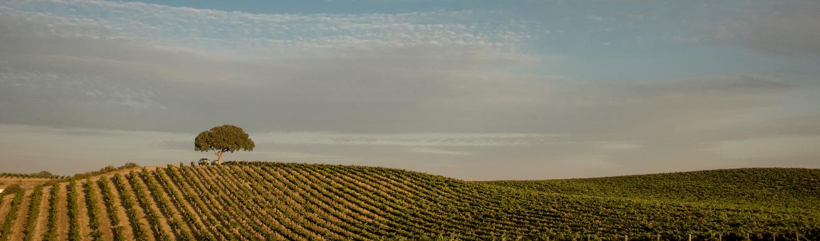
HISTORY
Paso Robles
1800s
Early to mid-1900s
Later 1900s
Franciscan Friars introduced grape growing
First winery was founded
Zinfandel reigns supreme
Dr. Stanley Hoffman & André Tchelistcheff, planted region’s first Cabernet Sauvignon
1983 – Paso Robles AVA established
1997 - Justin’s Isosceles Top 10 Wine
2013 – Wine Region of the Year by Wine Entusiast
2014 – 11 sub-AVAs approved
Photo from pasowine.com © 2020 Napa Valley Vintners and Napa Valley Wine Academy
Notes:
1790: Winemaking and wine grape growing introduced by the Franciscan Friars
1828: Name recorded as “El Paso de Robles” (the pass of the oaks), but later shortened to Paso Robles.
1882: 1st winery where York Mountain Winery is today and planted Zinfandel
1920-1930: Zin flourishes – Pesenti, Dusi vineyards just to name a few
1960s-1970s: Dr. Stanly Hoffman plants CS, PN, CH – Hoffman Mountain Ranch Vineyard (now Adelaida)
1970s: Gary Eberle and Syrah’s first commercial vineyard
1983: AVA
1997: JUSTIN Vineyards & Winery’s Bordeaux-style ISOSCELES named one of the top 10 wines in the world by the Wine Spectator
2014: 11 nested AVAs approved
Today in Paso Robles – next slide

Slide 43
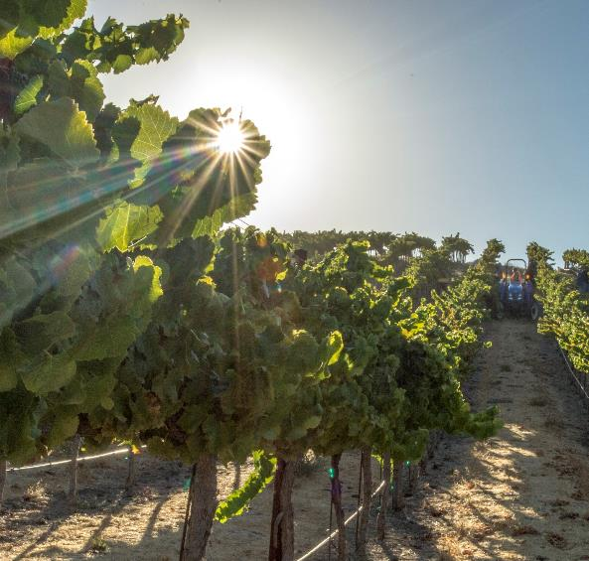
FAST FACTS
Paso Robles
46 grape varieties
200+ wineries
  Most family owned
40,000 planted acres
Cabernet Sauvignon is #1 grape variety
  49% of production
© 2020 Napa Valley Vintners and Napa Valley Wine Academy

Slide 44
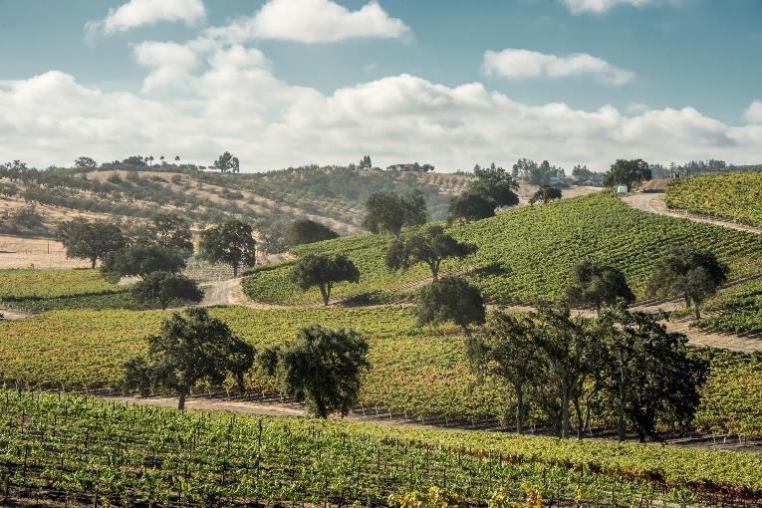
CLIMATE
Paso Robles
Mediterranean
  Warmer further inland
Widest temp swings of any CA appellation
Distinct microclimates
Picture courtesy of sonomawine.com
© 2020 Napa Valley Vintners and Napa Valley Wine Academy
Notes:
AVA is 35 miles wide and 25 miles N to S
Paso Robles Willow Creek District (close to the coast) is Region II based on Degree Days with average 20F diurnal shift during the growing season
whereas further inland the Paso Robles Highlands District is Region IV and has 50+F diurnal swings.
This is due to where the fog from the Pacific Ocean can make its way inland
Large temperature swings are the norm due to the Templeton Gap in the Santa Lucia range.
Creating 11 nested AVAs was a smart move, even though at first some found it more confusing, because there are so many distinct microclimates

Slide 45
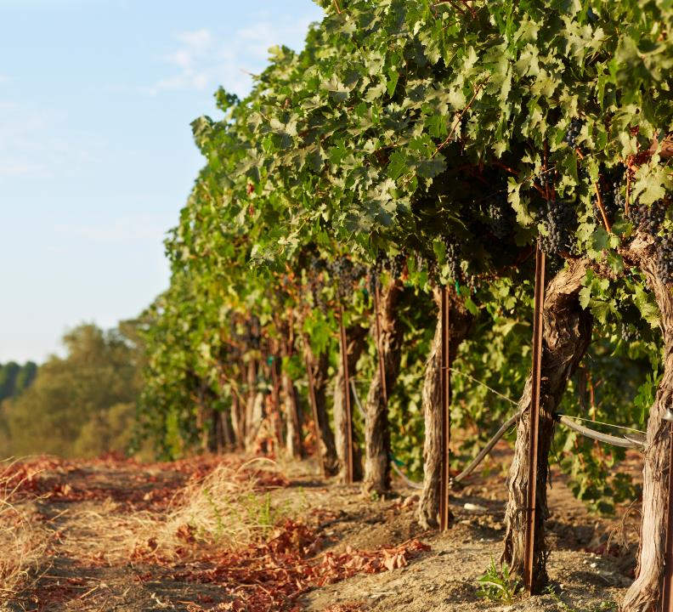
SOIL
Paso Robles
Over 30 soil series
Vineyard blocks commonly contain several types
Calcareous-clay soils in the west allows for dry-framing
© 2020 Napa Valley Vintners and Napa Valley Wine Academy
Notes:
Over 30 parent soil series are found in the Paso Robles AVA – again Napa has 33 and covers a much smaller area
Granite, marine sediment and volcanic bedrock
Calcareous shale is plentiful, especially on Paso Robles’ west side hills, where it combines with clay-based soils and plentiful winter rainfall to make it possible for some vines to be dry-farmed.
Further inland is much dryer and requires irrigation

Slide 46
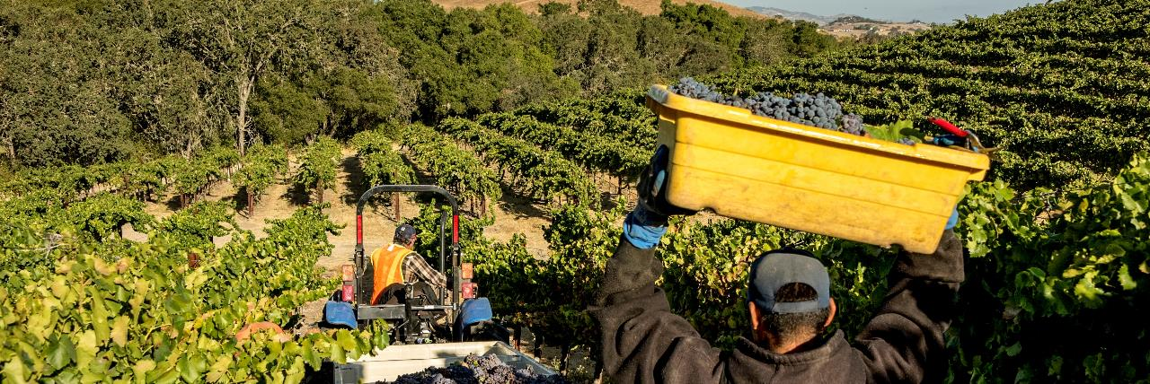
Paso Robles
GRAPEGROWING
Optimal growing conditions for premium /ultra-premium Cabernet Sauvignon
Rolling hills east of the Salinas River
Steeper hillsides west of the Salinas River
Ranks 3rd in acreage behind Sonoma and Monterey
Paso Robles
© 2020 Napa Valley Vintners and Napa Valley Wine Academy
Notes:
With a greater day-to-night temperature swing than any other appellation in California, distinct microclimates, diverse soils and a long growing season, Paso Robles is a unique wine region blessed with optimal growing conditions for producing premium and ultra-premium wines
Cab Sauv more prevalent on the vineyards east of Salinas River (Hwy 101), but aspect has a big impact on where it does best
There are a number of distinct grape growing regions generally characterized by rolling hills east of the Salinas River and steeper hillsides, cut by small canyons, west of the Salinas River
California’s fastest growing wine region
Ranks 3rd in acreage behind Sonoma & Monterey (Napa 4th)

Slide 47
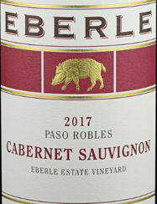
PRODUCTION RULES/LABEL LAWS
Paso Robles
Rules, with some exceptions
  75% grape variety
  State = 100%
  County = 75%
  AVA = 85%
  Vineyard = 95%
Labels MUST say Paso Robles if also labeled with an AVA entirely within the Paso Robles AVA - 2007
Notes:
Conjunctive labelling in 2007
The AVA system was launched in 1980 by the US government under the branch of the Alcohol and Tobacco Tax and Trade Bureau, aka TTB, in order to recognize specific regions for growing wine grapes.
It might surprise you to know that Napa Valley was not the first official AVA in the US. It was Augusta MO
Rules, with some exceptions
75% grape variety
State = 100%
County = 75%
AVA = 85%
Vineyard = 95%

Slide 48
STYLE
Paso Robles
Napa Valley Cabernet Sauvignon
Deeply colored; high, fine-grained tannins; bright acidity; full-bodied
Generous use of new oak – baking spices and toast
Powerful, rich, blackberry, black cherry, ripe plum
Great aging potential
Single varietal or blended
Valley vs. mountainside sourcing
Paso Robles Cabernet Sauvignon
Ripe, balanced and fresh from long hangtime
Intense and concentrated with fruit-forward aromas and flavors
Similar to Napa but with riper, softer tannins, warming alcohol
© 2020 Napa Valley Vintners and Napa Valley Wine Academy
Notes:
CS here is beautifully ripe but at the same time balanced and fresh from the acidity that is retained during those chilly nights
To paint Paso Robles Cabernet in broad strokes, though, is to do it a disservice, as it is in Napa
That said, the Cabernets here are intense and concentrated with fruit-forward aromas and flavors
Similar flavors to Napa but with riper, softer tannins and warming alcohol
In the last decade, the Cabernet producers honed their growing practices and cellar efforts, and they are turning out complex, more elegant bottles, as opposed to the very ripe Cabs in the past
Generally priced lower than Napa and Sonoma, but there are a few expensive outliers
And if you think about it, Paso Robles is not too far from Los Angeles where visitors can easily drive to and spend money, just like Silicon Valley folks travel to Napa.

Slide 49
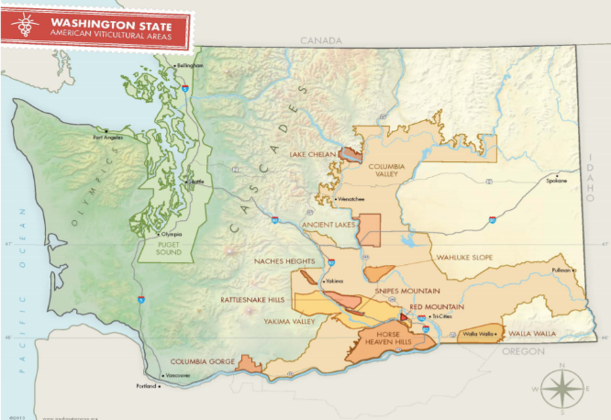
MAP
Washington State
95% of vineyards east of Cascade Mountains
Columbia Valley is largest AVA
Yakima Valley was 1st AVA
Map and data sourced from washingtonwine.org
© 2020 Napa Valley Vintners and Napa Valley Wine Academy
Notes:
Western half of the state sits in the last temperate rainforest on earth, while east of the Cascades is a desert-like due to the rain shadow effect.
95% of its vineyards are located east of the Cascade Mountains, and the arid land necessitates irrigation.
Columbia Valley AVA is the largest appellation in the state, covering 11 million acres—over one-quarter of Washington’s landmass.
Most of Washington's other AVAs, including Yakima Valley, Walla Walla Valley, and Horse Heaven Hills—the most important vineyard areas in the state—are nested within its borders.
Yakima Valley was approved as Washington’s first AVA in 1983; it contains over one-third of the state’s vineyards, and it also has three nested AVAs: Snipes Mountain, Rattlesnake Hills, and Red Mountain all significant for producing excellent CS.
Red Mountain is Washington's warmest growing region and its smallest. It has developed a reputation for noteworthy, powerful, tannic Cabernet Sauvignon
Walla Walla Valley, along with Yakima Valley and its nested AVAs, also produces great CS.
.

Slide 50
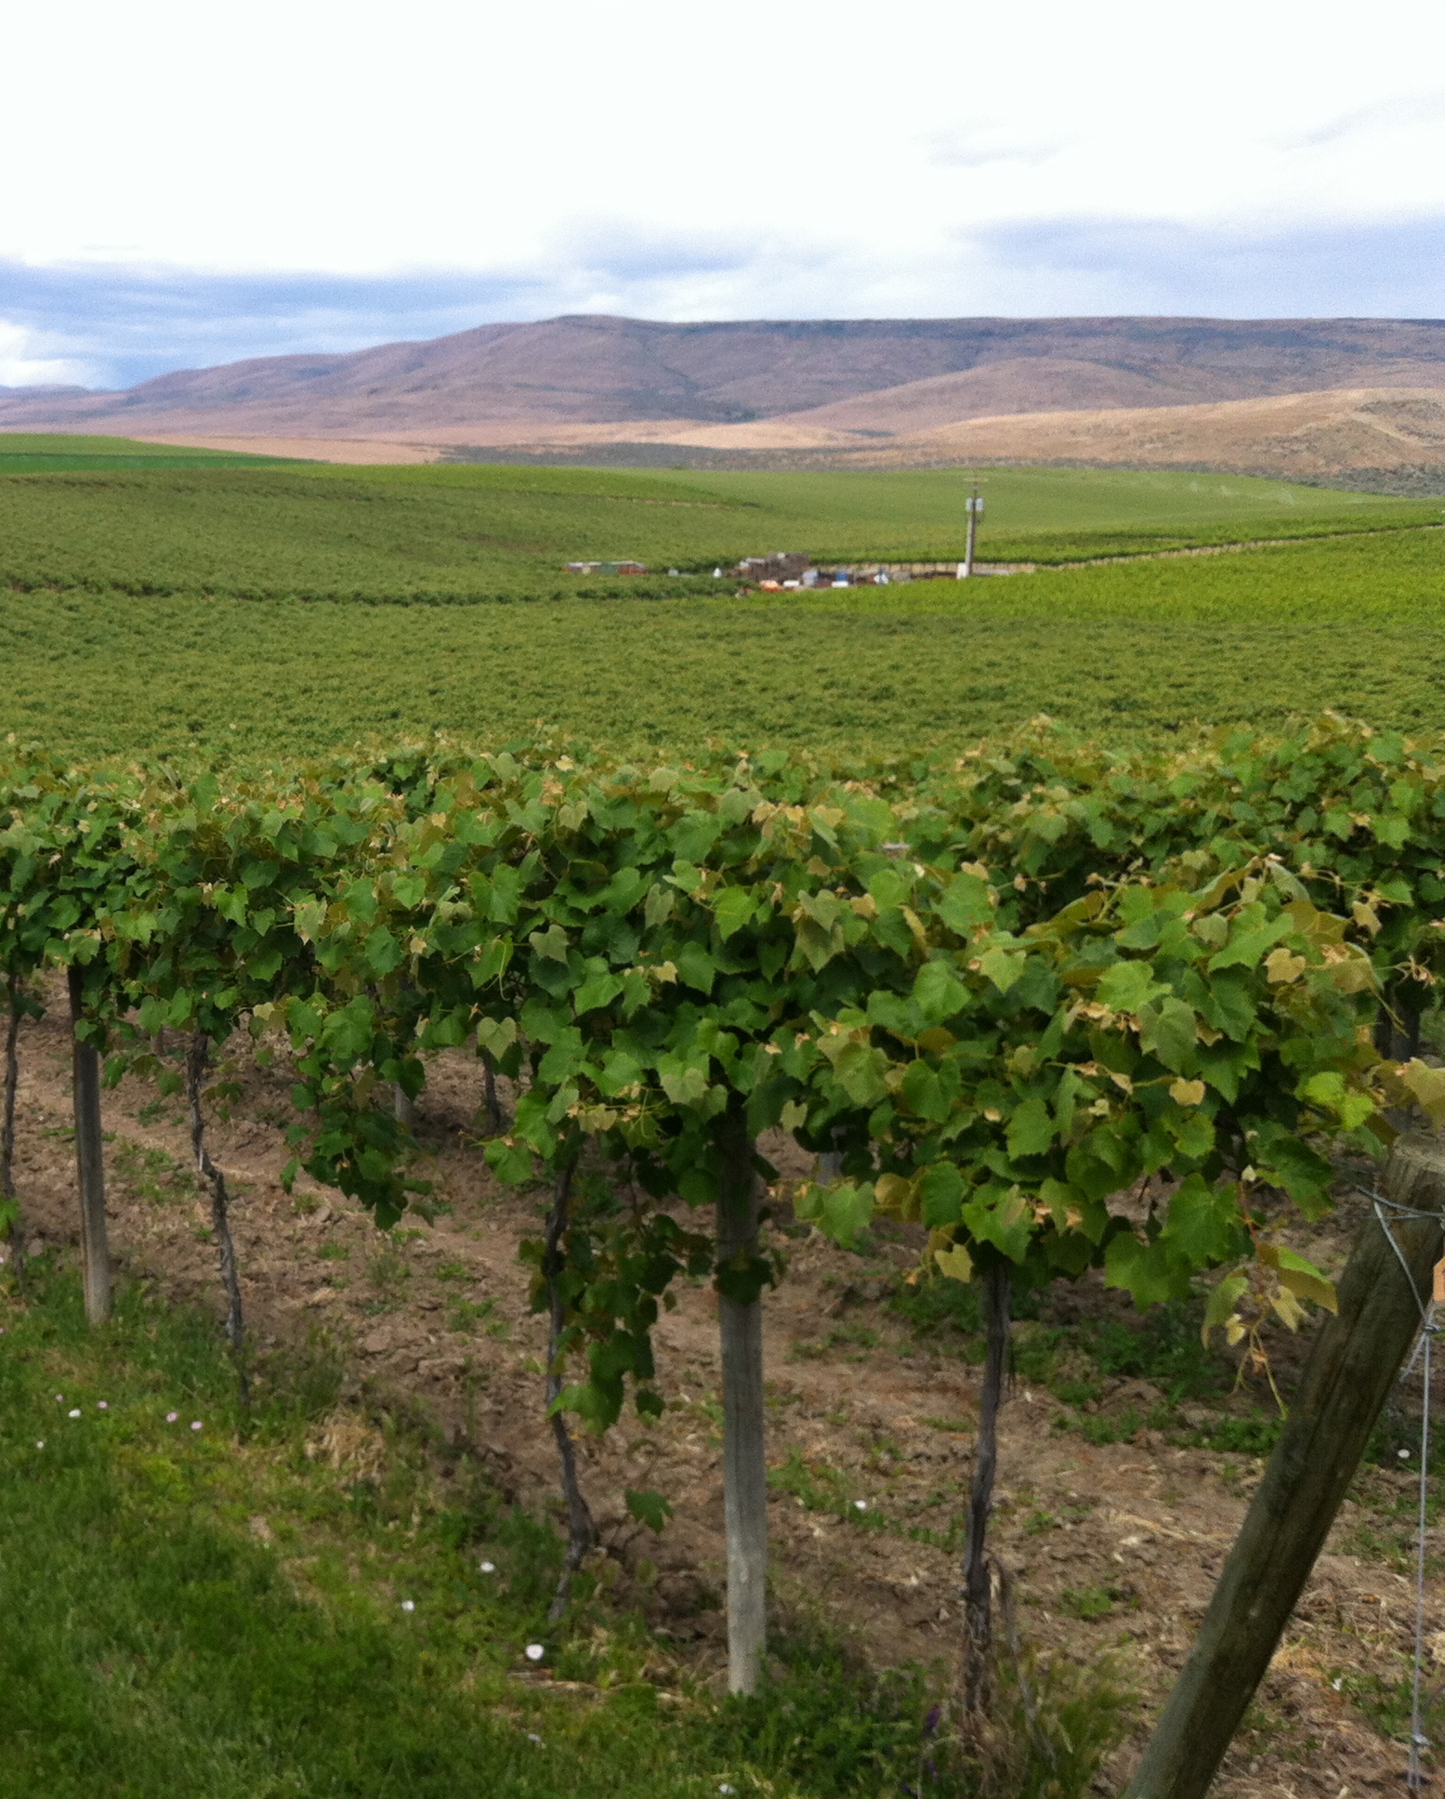
What famous winemaker helped guide and mentor Washington’s modern winemaking?
© 2020 Napa Valley Vintners and Napa Valley Wine Academy
Notes:
Pinot = pine cone shape

Slide 51


Notes:
Chateau Ste. Michelle
1967

Slide 52
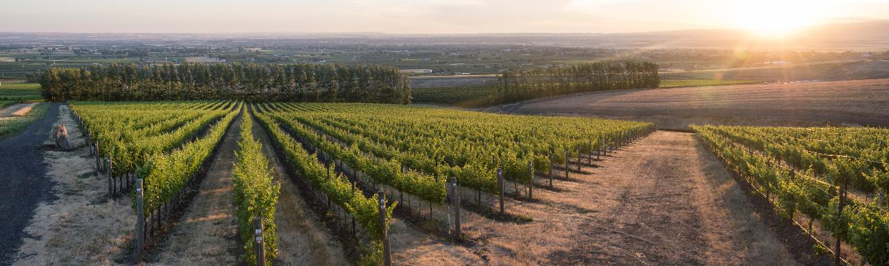
HISTORY
Washington State
1800s
Early to mid-1900s
Later 1900s - Today
1st grapes planted in 1825
Irrigation began in eastern WA in 1903 unlocking grape growing potential
Rapid growth until Prohibition
Commercial-scale began 1960s
Andre Tchelistcheff mentored modern winemaking in WA
Rapid growth
1987 Washington State Wine Commission
2003 investment by Washington Wine Institute
Photo from pasowine.com © 2020 Napa Valley Vintners and Napa Valley Wine Academy
Notes:
Washington’s first grapes were planted at Fort Vancouver in 1825.
Large-scale irrigation, fueled by runoff from the melting snowcaps of the Cascade Mountains, began in eastern Washington in 1903, unlocking the potential of the area’s sunny, dry climate.
Italian and German varietals were planted in the Yakima and Columbia Valleys and wine grape acreage expanded rapidly in the early part of the 20th century.
The arrival of Prohibition in 1920 put a damper on wine grape production, but ironically may have helped spawn early interest in home winemaking.
The first commercial-scale plantings began in the 1960s.
Andre Tchelistcheff consulted with and helped guide Chateau Ste. Michelle’s early efforts and mentored modern winemaking in the state.
1,000+ wineries in WA today
Over 40% of these vines have been planted in the last 10 years as the industry rapidly expands.
Washington State Wine Commission, similar to the NVV, was established in 1987. Great website for information
In 2003, the Washington Wine Institute invested $2.3 million investment to create new 2-year and 4-year degree programs supporting Washington’s growing wine industry.
5 years ago a world-class Wine Science Center at Washington State University opened in June 2015, which the industry helped fund
WA state has strong educational programs to prepare students for future careers in the wine industry just as Napa Valley does with NV College and UC Davis.

Slide 53

FAST FACTS
Washington State
2nd largest premium wine producer in US
5% of total US production
14 AVAs
70+ varieties planed
  59% red wine
Cabernet Sauvignon is #1
60,000+ acres planted
1/3 planted to Cabernet Sauvignon
© 2020 Napa Valley Vintners and Napa Valley Wine Academy
Notes:
2nd largest premium wine producing State in the US, accounting for 5% of the nations wine
14 nested AVAs
Many varieties are successful in WA and…
59% of production is of red wine
60,000+ acres planted, almost 19,000 acres is Cabernet Sauvignon
WA wine has become an influential $8.4 billion-plus industry within the state.

Slide 54

CLIMATE
Washington State
Continental
Northernly latitude
  Short season
  1 hour more sun per day than Napa
Vineyards east of Cascades
  Dry, continental climate
  Diurnal swings
Winter freeze
Map and data sourced from washingtonwine.org
© 2020 Napa Valley Vintners and Napa Valley Wine Academy
Notes:
Continental
Being so far north in latitude the growing season is shorter than regions further south, but the additional daylight hours means the grapes still ripen.
Despite having a slightly shorter growing season because of its northerly latitude, the number of sun hours received in Washington is equal to Napa Valley due to the incredibly long days at this higher latitude.
The growing regions receive an average of 16 hours of sunlight per day in the growing season (1 hour more than Napa)
Dry continental climate
Only 7-12 inches of rain fall in Eastern Washington during the year due to rain shadow, as opposed to 35-38 inches in the western region.
Low disease pressure
Irrigation is essential
Warm-to-hot days in the high 80s and 90s during the growing season, with large diurnal swings maintain freshness/acidity, again similar to Napa Valley
And winter freeze and vine kill is a major hazard in the region, but again, CS can withstand this well.

Slide 55

SOIL
Washington State
Missoula Floods
  Massive reoccurring floods at the end of the ice age
  Bedrock is basalt overlaid by sediments
Eastern Washington
  Poor nitrogen content
  Excellent drainage
© 2020 Napa Valley Vintners and Napa Valley Wine Academy
Notes:
Generalizations can be made about soil and geology east of the Cascades—the bedrock is invariably basalt, overlaid by sediments deposited by the Missoula Floods, a catastrophic cycle of massive floods that occurred repeatedly at the end of the last ice age, some 12,000 to 18,000 years ago.
Vineyards in eastern Washington are thus generally planted on sandy or silty loam soils derived from the flood-borne sediments.
Poor Nitrogen Content in these types of soils, makes the vines work harder to send nutrients to the grapes thus spending less energy on the foliage.
Sandy/rocky soils provide excellent drainage and the vine’s roots must dig deep to find it.
Despite broad similarities in climate and soil, however, eastern Washington's vineyards tend to be spread out, with great distances between large vineyard plots.

Slide 56

GRAPEGROWING
Washington State
Planted on own rootstock
Dry conditions and winter freeze
Lack of nutrients require fertilizing
Low rainfall requires irrigation
Cabernet Sauvignon requires long hang time to reduce green flavors
Harvest before winter freeze
© 2020 Napa Valley Vintners and Napa Valley Wine Academy
Notes:
The region is planted on its own rootstocks because phylloxera cannot survive the harsh winters and the region is so isolated.
These cold winter temperatures kill many vineyard disease-carrying pests such as phylloxera, moths, mites and nematodes.
As a result, the viticulture is remarkably sustainable, many practicing organic and pesticide free.
Yet at the same time, there’s often a lack of nutrients in the soils and Eastern WA vineyards require fertilization. There is a strong presence of organic composts and teas being utilized to maintain proper health of the soil.
Washington has an abundance of water sources, from the Columbia River basin for irrigation - which is essential on these soils
Due to the high drainage of the soil and the heat of the summer the more sensitive Cabernet and Merlot vines will often shut down and stop metabolizing sugars, allowing the grapes to hang well into September and October to ripen and avoid green, herbal flavors.
But one challenge they have which Napa doesn’t is that they must harvest before early autumn freezing temperatures hit. Ripeness – both sugar and physiological ripeness – may be affected if they must harvest before the freezing temperatures occur.
Unlike Napa, machine harvest is very common
As Cabernet is such a late ripener and green flavors are not desirable the grapes will often hang until the leaves turn yellow and start falling off, it is at this point that the vines are dumping K (potassium) into the fruit (making them more appealing to birds) and acid levels plummet.
For this reason acidulation is always required to adjust pH in the wine

Slide 57

PRODUCTION RULES/LABEL LAWS
Washington State
Label Rules
Washington = 95% grown in Washington
Washington & AVA wholly within Washington = 95% grown in Washington
Washington & adjoining AVA = 95% grown in the AVA or in Washington
Notes:
What are the standards for claiming or implying that the appellation of origin is “Washington?”
If the label states “Washington,” at least 95 percent of the grapes used in the production of the wine must have been grown in Washington.
If the label states “Washington” and the name of an American Viticultural Area (AVA) located entirely within Washington, at least 95 percent of the grapes used in the production of the wine must have been grown in Washington.
If the label states “Washington” and the name of an AVA located in both Washington and an adjoining state, at least 95 percent of the grapes used in the production of the wine must have been grown in the AVA or in Washington.
Overlapping AVAs with OR - Walla Walla and Columbia Gorge
Lewis-Clark Valley with Idaho

Slide 58
STYLE
Washington State
Napa Valley Cabernet Sauvignon
Deeply colored; high, fine-grained tannins; bright acidity; full-bodied
Generous use of new oak – baking spices and toast
Powerful, rich, blackberry, black cherry, ripe plum
Great aging potential
Single varietal or blended
Valley vs. mountainside sourcing
Washington State Cabernet Sauvignon
Inky purple with high alcohols
Moderately fresh acidity
Firm tanning from fruit and oak
Savory notes with classic cassis, chocolate, mint, herbs and dark earthy notes
Big, structured in the Napa model with less elegance and more foursquare
© 2020 Napa Valley Vintners and Napa Valley Wine Academy
Notes:
The wines are generally inky purple with high alcohols and moderately fresh acids
Firm tannins derived from both fruit and oak – especially grainy tannins if the grapes are harvested earlier than desired due to an early freeze
Savory Cabernets, with classic cassis, mint and some dark earthy humus notes.
The wines are big and structured and are made in the model of Napa but few have the elegance and detail that Napa Cabernet displays.
I find many of the Cabernet can be Foursquare = lacks some subtlety or nuances and is more direct and rock-solid in its flavor and structure.
Is Syrah or Riesling in their future?

Slide 59
MAP
France
© 2020 Napa Valley Vintners and Napa Valley Wine Academy

Slide 60

Notes:
Renowned wine region in SW France
Bordeaux enjoys the distinction of being the largest AOC vineyard of France, and this can be attributed to its great diversity of high-quality terroirs.
We separate the Left and Right Banks

Slide 61

MAP
Bordeaux
60 diverse appellations
Produces 15% of all French wine
Approx 6,000 chateaux
Broad range of wines and prices
© 2020 Napa Valley Vintners and Napa Valley Wine Academy
Notes:
60 diverse appellations
Produces 15% of all French wine
89% RED compared to 76% Red in NAPA
Approx 6,000 chateaux
The broad range of wines and prices that it produces offers wine lovers a wide selection to choose from

Slide 62

HISTORY
Bordeaux
1st Century to Middle Ages
Turn of the 20th Century
The 20th Century
Romans Plant 1st vineyards
Ruled by Britain and trade flourished
Medoc drained and vineyards planted
1855 Classification System
Phylloxera led to grafting
Bordeaux mixture developed
INAO founded 1936
1972 – chateau bottling mandatory for classified growths
Merlot dominant variety
Photo from bordeaux.com © 2020 Napa Valley Vintners and Napa Valley Wine Academy
Notes:
Bordeaux wine has been produced here since the Romans planted the first vineyards to make wine for the soldiers almost 2,000 years ago
Region takes its name from the region’s capital city.
In 1152 Eleanor, Duchess of Aquitaine married King Henry of England and for the next 300 years the region was under English rule.
Bordeaux wine trade flourished as a result of trade with England
In the 17th century, Dutch began to drain the marshland around the Médoc on the Left Bank and planted more vineyards.
1855 Classification for Medoc, Sauternes + Haut Brion
In the late 19th century, almost all Bordeaux vineyards were destroyed by Phylloxera, then rescued by grafting native French vines onto pest-resistant American rootstock.
1882: Bordeaux mixture was discovered – sulfur and copper to combat downy mildew (more problematic than powdery mildew)
Easier to grow grapes in Napa
In order to guarantee quality and provenance, the INAO or Institut National des Appellations d’Origine, passed laws in 1936 stating that all regions in France had to name their wines by the place in which they had been produced.
1972 – chateau bottling mandatory for classified growths – used to be bottled in London
Within Bordeaux the more agriculturally dependable Merlot is almost three times as popular. For Reds 22.5% is CS vs. 66% for Merlot
Cabernet’s stronghold is on the left bank of the River Gironde, most notably the famously well-drained gravels of the Médoc and Graves.

Slide 63

1855 Classification System
Commissioned by Emperor Napoleon III
Ranked top properties of Bordeaux by price
Outstanding, unclassified wines or appellations are also common
Notes:
Bordeaux introduced the concept of classification in 1855 under Napoleon III, and it now serves as an expression of quality and prestige worldwide.
Ranked the top properties of Bordeaux by price prior to international exposure at the Universal Exposition in Paris later that year
Only Medoc (and Sauternes) plus Ch. Haut Brion
1st through 5th growth
It should be emphasized that a wine or appellation can still be outstanding even if it is not a part of these classifications!
The Crus Artisans classification
1973 Mouton $850 vs $350
There are several classifications in Gironde, listed in order of seniority:
The 1855 classification
The Graves classification
The Saint-Émilion classification
The Crus Bourgeois du Médoc cla

Slide 64

1855 classification
4 - 1st Growths
15 – 2nd Growths
14 – 3rd Growths
10 – 4th Growths
18 – 5th Growths
Chateau Mouton Rothschild – 2nd Growth
“First, I cannot be. Second, I do not deign to be. Mouton I am.“
"First, I am. Second, I used to be. Mouton does not change."
Notes:
1973 Mouton $850 vs $350
Nowadays price is perhaps, but not always, a better indication of quality
Yet the 1855 Classification is still held up as a measurement of greatness and uniqueness of Bordeaux
THE FIVE BORDEAUX WINE CLASSIFICATIONS
Bordeaux introduced the concept of classification in 1855 under Napoleon III, and it now serves as an expression of quality and prestige worldwide. The principle of the crus classés (“classified growths”) perfectly illustrates the synthesis of a terroir’s typical characteristics and dedicated human intervention over many generations to ensure quality.
It should be emphasized that a wine or appellation can still be outstanding even if it is not a part of these classifications!
There are several classifications in Gironde, listed in order of seniority:
The 1855 classification
The Graves classification
The Saint-Émilion classification
The Crus Bourgeois du Médoc classification
The Crus Artisans classification

Slide 65

QUIZ
Bordeaux
What is the average bottle price of a Bordeaux wine?
$7
$15
$25
$75
Notes:
$6.48 bottle price vs. $35-$40 for Napa? but no one knows for sure, unless some of you might know.

Slide 66
QUIZ
Bordeaux
What is the average bottle price of a Bordeaux wine?
$7
$15
$25
$75
Notes:
$6.48 bottle price vs. $35-$40 for Napa? but no one knows for sure, unless some of you might know.

Slide 67

FAST FACTS
Bordeaux
Produces 80 million cases of wine
2.6% of world’s production
More than 25% of all French AOC wine
Only 5% of Bordeaux’s production goes into Classified Growths
$6.48 average bottle price
Notes:
Produces 80 million cases of wine vs. <10 million in Napa
So if Napa is 1/6 the size of Bordeaux, yet the production 1/8, then the yields in Bordeaux are much higher
2.6% of world’s production
More than 25% of all French AOC wine
Only 5% of Bordeaux’s production goes into Classified Growths
$6.48 bottle price vs. $35-$40 for Napa? but no one knows for sure, unless some of you might know.

Slide 68

CLIMATE
Bordeaux
Maritime climate
Cold, wet winters, spring frost, hot, humid summer
Rain during growing season & harvest
Wide vintage variation
Photo from https://weather-and-climate.com/average-monthly-Rainfall-Temperature-Sunshine,Bordeaux,France
© 2020 Napa Valley Vintners and Napa Valley Wine Academy
Notes:
The region of Bordeaux sits adjacent to the Atlantic Ocean which provides it with a temperate maritime climate.
Straddled by two bodies water, the Atlantic and the Gironde estuary, they act as moderating influences on the region protecting the vines from winter freezes and spring frost, but the latter can occur
Winters are relatively mild and short, springtime is generally damp and summers reach high temperatures.
Coastal pine forests protect the Médoc vineyards from harsh west and northwesterly winds, as rain from the Atlantic can be a problem, especially at flowering and harvest.
The growing season is mild and variable, fall rains declare the end of the vintage
For this reason much of the cabernet in Bordeaux will be harvested at potential alcohols of 12-13.5%.
Vineyards closer to the river benefit from more gravel and silt soils, reflected sunlight and movement of air from the full and flowing Gironde.

Slide 69


SOIL
Bordeaux
Médoc & Graves
High gravel content
Extra warmth means Cabernet Sauvignon ripens well
Right Bank
Clay, limestone, sand, little gravel
Cooler soils means only Merlot can ripen
© 2020 Napa Valley Vintners and Napa Valley Wine Academy
Notes:
Cabernet Sauvignon is primary grape in Medoc and Graves (aka “Left Bank”)
Merlot, Petit Verdot, Malbec and Cabernet France play supporting role
Finest wines grown on gravel soil which are warmer than clay soils, thus CS thrives here.
Provides excellent drainage
Reflects sunlight
Grapes are more concentrated/flavorful
“Left Bank” wines have more tannin and bigger structure than “Right Bank”

Slide 70

GRAPEGROWING
Bordeaux
Mix of varietals planted to insure successful vintage
10% of vineyards are organic or experimenting with organic farming
Biodynamic farming rising
Hand and machine harvesting common
© 2020 Napa Valley Vintners and Napa Valley Wine Academy
Notes:
Due to the timing of the rains in Bordeaux, grape growers have traditionally planted a mix or early and late varieties in order to hedge their bets for a successful vintage and to avoid under ripe green fruit or herbaceous flavors.
Typically in the Médoc, the usual blend is 75% Cabernet Sauvignon with a mixture of Merlot, Cabernet Franc and sometimes a little Petit Verdot.
55% of Bordeaux’s vineyards are practicing sustainable farming
10% of vineyards are organic or experimenting with organic farming
Biodynamic farming rising
Hand and machine harvesting common. Machine is easy because Bordeaux generally very flat.
The majority of the regions great Cabernet vineyards are planted within sight of the Gironde estuary and on gravel soils with less clay content than the right bank. Vineyards closer to the river benefit from more gravel and silt soils, reflected sunlight and movement of air from the full and flowing Gironde.

Slide 71


WINEMAKING
Bordeaux
Modernized in the 1970s
Blending is fundamental
Drive to find compromise between tradition and modernity
Micro-oxygenation increasingly popular
Top chateaux will make 2nd and/or 3rd wine
© 2020 Napa Valley Vintners and Napa Valley Wine Academy
Notes:
University of Bordeaux is their UC Davis

Slide 72
STYLE
Bordeaux
Napa Valley Cabernet Sauvignon
Deeply colored; high, fine-grained tannins; bright acidity; full-bodied
Generous use of new oak – baking spices and toast
Powerful, rich, blackberry, black cherry, ripe plum
Great aging potential
Single varietal or blended
Valley vs. mountainside sourcing
Bordeaux Cabernet Sauvignon
Very aromatic, with distinct black fruit, blackcurrant, licorice, tobacco and earth
High acidity with firm, fine-grained tannins
Extended ageing is common for flavor development and to soften tannins
Blending is common
  Merlot is a natural blending partner to add body, roundness, herbs and red fruit
  Petit Verdot adds extra spice
  Cabernet Franc contributes violet perfume
© 2020 Napa Valley Vintners and Napa Valley Wine Academy
Notes:
One of Bordeaux’s secret is its advantageous tannins that give it great aging potential.
To me, Bordeaux always has a certain angular, crunchy style to it, with an earthiness even in ripe, hot vintages – which you is not the case with Napa
Sometimes Brett is evident, not as much as in the past, but consumers seem to accept this from Bordeaux
At best, the wines of the Médoc are medium-plus in body with bright, but rarely luscious, black fleshed berry fruits like ripe blackberry and mulberry, except in the hottest vintages
Aside from the grapes itself, the climate of a particular region can also greatly impact the wines personality, especially aromas and flavors.
Left Bank style:
Usually dominated by Cabernet Sauvignon so more tannic
Powerful, punchy style
Concentrated aromas and flavors of dark fruit which develop into truffle, cigar box, leather and spices with ageing
Often plenty of acidity as the grapes can struggle to ripen fully
Often require further ageing after release to soften their tannins, sometimes for decades, although like many places in the world, Bordeaux is making wines that are easier to drink when young, but not as easy as Napa is.
Right Bank style:
Usually dominated by Merlot so less tannic
Softer, juicier style
Rich aromas and flavours of dark berries, chocolate and licorice which can develop into tobacco, fresh herbs and spices with ageing
Easier to drink young
Extended ageing can produce beautiful mature wines
Compared to Napa, which show darker fruit and spice, warmer/higher alcohols and softer acids than Cabernet from Bordeaux
Often a single variety unlike in Bordeaux

Slide 73
MAP
ITALY
© 2020 Napa Valley Vintners and Napa Valley Wine Academy

Slide 74

MAP
Italy/Tuscany
Sangiovese dominates Chianti DOCG
Can be blended with Cabernet Sauvignon & others
Sassicaia in 1968
Bolgheri, Maremma considered ground zero for red Super Tuscan blends
© 2020 Napa Valley Vintners and Napa Valley Wine Academy
Notes:
While Sangiovese dominants the DOCG wines of Chianti and Tuscany, the region had diminished in its nobility in the 60’s and 70’s with straw covered wine bottles of cheap, not very good Chianti.
However, over the last 50 years, the Super Tuscan style, first released as Sassicaia in 1968 (by Marquis Rocchetta Tenuta San Guido) brought in barrel-aged Cabernet blend from Bolgheri and labelled as vino da tavola, is seen by many as being responsible for Tuscany’s return to noble wine production.
The French varieties added richness and flesh to the more acid-driven and austere Sangiovese.
Today Chianti can have up to 15% CS and Chianti Classico can have up to 10% CS
Bolgheri and the Maremma are typically considered ground zero for red Super Tuscan blends

Slide 75

Notes:
The Bolgheri region on the Tuscan coast, home of the famed Super Tuscans, is bathed through out the growing season in the warm breezes off the Tyrrhenian Sea and in the afternoons with cool air flowing from the spine of Apennine Mountains further inland.
The soils are well drained sand and loams, unique to the region.
Maremma is similar but warmer in the larger inland area.

Slide 76

HISTORY
Italy
Mid-1800s to mid-1900s
Late 1900s
1992
CS in Piemonte region in 1820 as blender
In many regions, including Chianti
DOCG rules of Chianti limited its use
Sassicaia CS blend released in 1968
Tignanello released in 1978
Relegated to be called Vino de Tavola
DOC laws allowed more CS
“Super Tuscan” term coined
IGT category created under pressure
© 2020 Napa Valley Vintners and Napa Valley Wine Academy
Notes:
Cabernet Sauvignon has a long history in Italian wines, being first introduced to the Piedmont region in 1820.
As mentioned, CS is allowed in Chianti to add dark fruit and body to the wine.
Sassicaia CS blend released in 1968
Tignanello released in 1978
In the mid-1970s, Cab Sauv earned notoriety and controversy as a component in the so-called "Super Tuscan" wines of Tuscany.
Many winemakers also felt stymied by the DOCG laws because they didn’t follow the Chianti recipe, thus they fell into the low-class Vino da Tavola category yet being some of the highest priced wines in Italy.
IGT (Indicazione Geografica Tipica) was introduced in 1992, to allow a certain level of freedom to Italy's winemakers.
Many other producers began to create Super Tuscans, a term coined by either Robert Parker or Burton Anderson or David Cleave MW
Bolgheri DOC in 1983, Bolgheri Sassicaia (DOC in 2013), and Maremma (DOC in 2011) wines are permitted to be produced from pure varietal Cabernet Sauvignon, Merlot, and Cabernet Franc or Bordeaux-style blends with Syrah or Sangiovese.
Today - Gaja Darmagi is nearly all CS

Slide 77

QUIZ
Italy
Sangiovese is the most widely planted red grape in Tuscany. Which grape comes in second?
Cabernet Sauvignon
Colorino
Merlot
Syrah
© 2020 Napa Valley Vintners and Napa Valley Wine Academy

Slide 78
QUIZ
Italy
Sangiovese is the most widely planted red grape in Tuscany. Which grape comes in second?
Cabernet Sauvignon
Colorino
Merlot
Syrah
© 2020 Napa Valley Vintners and Napa Valley Wine Academy
Notes:
Sangiovese is 2/3 off all vineyards
Trebbiano
CS
ML
SY
CF

Slide 79

FAST FACTS
Italy
28,000+ acres of Cabernet Sauvignon in Italy
20% of Italian Cabernet Sauvignon is planted in Tuscany
Cabernet Sauvignon is 2nd most planted red grape in Tuscany
Also found in Piedmonte, Veneto, Puglia and Sicily
© 2020 Napa Valley Vintners and Napa Valley Wine Academy
Notes:
Veneto (22%), Sicilia (21%), and Toscana (19%)
28,137 acres of CS planted
1/5th of Sangiovese planting
Primarily in Veneto (22%), Sicilia (21%), Toscana (19%)

Slide 80

CLIMATE
Italy/Tuscany
Mediterranean climate
Some maritime influence
Bolgheri
  Cool sea breezes
  Direct and reflective sunlight
Maremma
  “Wild West”
  Less maritime further inland
Notes:
Mediterranean climate and affected by the Tyrrhenian sea and wind
Its climate is warmer and more maritime than central Tuscany
While it gets warm here, over 100F, you don’t feel it because of the sea, but there is some humidity, unlike Napa which is very dry
Entire area is known as Maremma but Bolgheri was officially separated in 1983 as its own DOC
Bolgheri: (see picture)
Mountains and seacoast are parallel to each other with vineyards in a corridor in between
Cool sea breezes moderate the climate
Direct and reflective sunlight from the ocean
Slow ripening – lush, rich wines
Further inland as the elevation increases slightly (1,300), acidity is higher due to greater diurnal temperature swings
Maremma
Maremma is often referred to as the “Wild West”, both in terms of its landscapes and its winemaking
Larger and more diverse than Bolgheri is offers different landscapes and grows many grape varieties, both red and white
Maremma’s name comes from a Spanish word meaning “marsh” and indeed this area has been drained many times over the years (and only completely in 1930s) to make it more suitable for vineyards.
See more Sangiovese here especially at higher altitude sites.
The eastern edge of Maremma abuts the Montalcino region

Slide 81

SOIL
Italy/Tuscany
Bolgheri
  Sand
  Clay
  Rocky, alluvial soils
Maremma
  Clay and sand
  Loam and clay
  Limestones
  Multi-sized pebbles
  Volcanic in the east
Info and picture source: Wine-searcher.com
© 2020 Napa Valley Vintners and Napa Valley Wine Academy
Notes:
Years ago, this area was used for cattle grazing and growing grains, vegetables, and olive trees.
Bolgheri
Sand, found near the sea
Clay, which ranges up to approximately 270 feet elevation. Clay—she also called this brown soil—is fertile and retains water well.
Find some limestone mixed in with clay
Finally, alluvial soils on the hillsides
Sassicaia’s name means “stony field” referring to the banks of gravel in the area.
Maremma
Soils are similar but more varied

Slide 82

GRAPEGROWING
Italy/Tuscany
Cabernet Sauvignon is last to bud and ripen – perfect for region
Increasingly embracing sustainable practices
Modern, VSP-trained vines
© 2020 Napa Valley Vintners and Napa Valley Wine Academy
Notes:
Cabernet Sauvignon is last to bud and ripen – perfect for region
Increasingly embracing sustainable practices
Focus on terroir-driven wines and finding the best sites for variety and rootstock.
Vineyards are more modern and vsp trained in Bolgheri, this suite the Bordeaux varieties.

Slide 83

Production Rules/Label Laws
Italy
DOCG
DOC
IGT
Vino
Notes:
By law Bolgheri DOC must see one year of aging, many of these wines receive up to 3 years.
Bolgheri Superiore must be aged 2 years, of which at least one year is in oak, and minimum 12.5%

Slide 84
STYLE
Italy
Napa Valley Cabernet Sauvignon
Deeply colored; high, fine-grained tannins; bright acidity; full-bodied
Generous use of new oak – baking spices and toast
Powerful, rich, blackberry, black cherry, ripe plum
Great aging potential
Single varietal or blended
Valley vs. mountainside sourcing
Super Tuscan
Profile is between Napa and Bordeaux
CS dominates when blended with Sangiovese
Deeply colored, balanced yet soft acidity
Ripe black cherry and notes of black currant
Oak forward with earth, tobacco and clove
Delicious young and capable of aging
© 2020 Napa Valley Vintners and Napa Valley Wine Academy
Notes:
Profile is between Napa and Bordeaux. Maremma is warmer than Napa and Bordeaux
its application for DOC status cited an annual 1,747 growing degree days on the Winkler scale, well above both Napa and Bordeaux (1,370 each).
Thus its acidity is softer and rounder, making for delicious easy drinking in their youth, yet still capable of extended aging.
CS dominates when blended with Sangiovese
Ripe black cherry and notes of black currant
Oak forward with earth, tobacco and clove
Delicious young and capable of aging
Shows ripeness of Napa, but there’s the hallmark of “Italian spice” plus earth and herbs of Bordeaux
I will mention that on last year’s MW exam there was a Super Tuscan which many students put in Bordeaux because of the earthy quality, but quite a few thought OW such as Australia and Napa. Blind tasting is not always easy!!!

Slide 85
MAP
CHILE
South America
© 2020 Napa Valley Vintners and Napa Valley Wine Academy
Notes:
Winemaking arrived in the New World with Spanish conquistadores in the 16th century.
From Mexico the vine spread south through other Spanish colonies, from Peru to Chile and Argentina by 1560.
Despite a promising start, viticulture in South America suffered under a prohibitive 17th century Spanish law that restricted wine production to church wine and all else had to be imported from Iberian producers.
However, by the 1800s a new era of political autonomy in Argentina, Chile and Brazil through independence had arrived.
An influx of European immigration in 19th century, many fleeing the ravages of Phylloxera, along with the development of a national rail system, resulted in a rapid expansion of viticulture in Argentina.
These vine specimens served Chile well; its geographic isolation, due to the Andes, prevented phylloxera from entering the country.
Today, Chile is the only major winemaking country to remain entirely phylloxera-free

Slide 86


MAP
Chile
800 miles of Chile’s coast
Andes Mountains defines Chile’s geography
Cabernet Sauvignon’s best regions
  Aconcagua, Maipo, Rapel Valleys
© 2020 Napa Valley Vintners and Napa Valley Wine Academy
Notes:
Chile stretches for nearly 3,000 miles along the west coast of South America, separated from the remainder of the continent by the Andes Mountains.
Vines occupy 800 miles of Chile’s coast
Most major regions of production to the south of the capital city, Santiago
Andes Mts defines Chile’s geography
Natural border
Proves irrigation
Protects against pests and diseases
CS’s best regions
Aconcagua, Maipo, Rapel Valleys (Cachapoal and Colchagua)
High elevation, cold nights
Low summer rainfall

Slide 87

HISTORY
Chile
1548
1800s
Today
Conquistadors, Missionaries planted 1st vines
Cabernet Sauvignon arrived from France
Chile was spared from phylloxera
Great diversification
Strong global presence
Source: wineofchile.com
© 2020 Napa Valley Vintners and Napa Valley Wine Academy
Notes:
Winemaking arrived in the New World with Spanish conquistadores in the 16th century.
From Mexico the vine spread south through other Spanish colonies, from Peru to Chile and Argentina by 1560.
In the 18th century, Chile was known for the quantity and cheapness of wine it produced, much to the dismay of some Spanish wine producers who tried unsuccessfully to restrict production.
Chile also benefited from European expertise when in 1830 Frenchman Claudio Gay set up a Chilean repository of pre-phylloxers Vitis vinifera vines in Chile
Chile was spared from phylloxera which helped to bring French immigrants and their wine expertise to support the success of Chile’s industry
After unsettled politics in 1970s and early 1980s a significant moment occurred in the 1980s as democracy returned and when the Spanish producer Miguel Torres arrived in the country introduced modernized wine production.
His example was followed by Chilean producers, which led to a wave of new plantations and the sustained growth of wine exports.
Chile has since developed a great diversification of vines that has led to a strong global presence following decades of work.

Slide 88

FAST FACTS
Chile
Cabernet Sauvignon is most important grape
32% of all plantings
Vintage to vintage consistency
800 wineries
  4 control 80% of production
Phylloxera free
© 2020 Napa Valley Vintners and Napa Valley Wine Academy
Notes:
Cabernet Sauvignon is most important grape
Chiles grand total of (generally ungrafted) Cabernet Sauvignon grew from 40,000 acres in 1997 to 108,000 in 2018, making it the country’s most important variety
32% of all plantings
Vintage to vintage consistency
800 wineries
Concha y Toro, Santa Rita, Santa Carolina, and San Pedro control about 80% of production
While Chile experiments with new varieties and Carmenere.
800 wineries
Chile with its geographic isolation, due to the Andes, prevented phylloxera from entering the country.
Today, Chile is the only major winemaking country to remain almost entirely phylloxera-free
https://www.winesofchile.org/en
11,697 exporters
Wine accounts for 5.7% of Chile’s exports

Slide 89

CLIMATE
Chile
Coastal Region
  Humboldt Current and fog
Central Valley Region
  Mediterranean climate
Andes Region
  Cold air drains from Andes at night
Source: wineofchile.com
© 2020 Napa Valley Vintners and Napa Valley Wine Academy
Notes:
Chilean wine producers describe their climate as somewhere between that of California’s napa Valley and that of Bordeaux.
Generally dry, except in the south
Andes mountains provides irrigation through snowmelt and a natural barrier against pests and diseases.
Desert to the north, Antarctica to the south
More important to view climate from the standpoint of location from west to east instead of North-South
Coastal Range
Cool ocean currents from frigid water and air, creating fog like northern CA
Into Central Valley along rivers
Central Valley
Mediterranean climate
Intense sunlight
Cold nights
Andes
Cold air drains from Andes at night
DOs can, as of 2012, use three new geographic terms: Costa, Entre Cordilleras, and Andes on labels
These designations signify the proximity of a vineyard to the coast (Costa) or to the mountains. Entre Cordilleras ("between mountains") describes the valley areas between the coastal range and the Andes, a region in which over three-quarters of Chilean wine grapes are grown.
CS thrives in Aconcagua, Maipo, Cachapoal, and Colchagua Valleys. In these valleys, the great amount of sunshine, the breeze that comes down off of the Andes to cool the nights, and the absence of rainfall in the summer have made it possible to attain a consistently high-quality Cabernet

Slide 90

SOIL
Chile
Coastal Region
  Alluvial, some clay
Central Valley Region
  Sedimentary, sandy
  Cabernet Sauvignon thrives
Andes Region
  Rocky, free-draining
Source: wineofchile.com
© 2020 Napa Valley Vintners and Napa Valley Wine Academy
Notes:
Coastal
Alluvial with clay and a certain minerality in the wines
Central Valley
Fertile, river sediments and sand
CS grows easily here
Andes/Alto
Colluvial soils (those brought down from the mountains over time by gravity as opposed to rivers) are rocky and free-draining and are considered excellent for viticulture: vines have to work harder for water in the ground and so put their energy into producing smaller berries with a high concentration of sugars and acids.
Irrigation and fertigation are employed at the best quality properties to ensure grapes ripen evenly without stress during the hot summers.
The Aconcagua DO is named after the Aconcagua River. The sunny, dry Aconcagua Valley subregion follows the river as it flows from the Andes to the Pacific. Soils in the Aconcagua Valley are generally alluvial, and red grapes dominate the valley’s vineyards, particularly Cabernet Sauvignon and Merlot. Although much of the valley is distressingly hot for grape-growing, the commune of Panquehue, home to Errázuriz, is one of Chile’s most prominent estates and winemaking families, experiences a more moderate climate. Errázuriz’s “Seña,” an iconic Bordeaux-style blend and one of the premier reds of Chile, placed ahead of both Château Lafite and Château Margaux in the 2004 Berlin Tasting—a milestone for the Chilean wine industry likened to the famous 1976 Judgment of Paris.
The Central Valley DO, situated between the Andes and coast range, is Chile’s oldest and most established winemaking region. From north to south, the DO’s subregions are Maipo Valley, Rapel Valley, Curicó and, Maule Valley. The warm Maipo Valley is the most famed, and the classic region in the country for high quality Cabernet Sauvignon. Over 50% of the region’s more than 25,000 acres are planted, followed by Merlot, Syrah and Carmenere. Cabernet thrives on the well-drained, low slopes of the Andes, and some of Chile’s most premium red wines issue from the subregion of Puente Alto, such as Concha y Toro’s “Don Melchor” and Errázuriz’s “Viñedo Chadwick” Cabernet Sauvignon varietal wines, and “Almaviva”, a joint project between Baron Philippe de Rothschild (Mouton-Rothschild) and Concha y Toro. The 2000 “Viñedo Chadwick” took first place in the 2004 Berlin Tasting.
The Rapel Valley, divided into Cachapoal and Colchagua, is located to the south of Maipo. Although Cabernet Sauvignon’s position as the leading grape in both regions is firmly secure, Carmenère is growing in importance, and may soon eclipse Merlot as the valley’s second most cultivated grape. Colchagua is the larger, central portion of the valley, and is characterized by a warm climate and fertile soils. Colchagua historically is a region for bulk wine production.
Bree:
The vineyards of Alto Maipo (or Upper Maipo) run along the eastern edge of the Andes Mountains, where they benefit from elevations of 1300-2500ft (400-760m) above sea level. At this height, warm sun during the day is followed by colder nights, which slow ripening. This extends the growing season, leading to grapes with a balance of ripeness and acidity.
Alto Maipo, which encompasses the sub-regions of Puente Alto and Pirque, is the most prestigious of Maipo's viticultural areas. It is here that the vineyards of Don Melchor, Almaviva and Vinedo Chadwick can be found along the banks of the Maipo River and among the houses and buildings of Santiago itself.
Central Maipo (sometimes called Maipo Medio) is the lower-lying ground just to the west of Alto Maipo. The climate here is slightly warmer than in Alto Maipo, and the soils are slightly more clay-based and fertile, leading to a slightly less-refined style of wine. Cabernet Sauvignon is still the most-grown grape variety, but there are also substantial plantings of Carmenere vines, as the warmer climate is well suited to this iconic Chilean grape variety.
Maipo Bajo (or lower Maipo) near the town of Isla de Maipo. The wine industry here is more concerned with winemaking than viticulture, and while there are a few vineyards, there are many wineries. Some vineyards are planted near the river, where cool breeze create mesoclimates suitable for growing white-wine varieties, as well as Cabernet Sauvignon.

Slide 91

GRAPEGROWING
Chile
The Sustainability Code
  Voluntary guide for wine companies
  Vineyard, winery-bottling plant and social
Innovation
  Vineyards
  Sustainability
  Technology
Source: wineofchile.com
© 2020 Napa Valley Vintners and Napa Valley Wine Academy
Notes:
The Sustainability Code of the Chilean Wine Industry is a voluntary standard, which guides wine companies in the challenge of working sustainably on the basis of requirements in three complementary areas: vineyard, winery-bottling plant and social area .
The lines of R + D + aim to improve the competitiveness and sustainability of the vineyards, Currently working on three programs:
Vineyard Improvement Program: high sanitary condition, varietal identity and traceability.
Sustainability Program: related to climate change / geology, energy and water platforms, protocols for transporting wine, pesticides, biodiversity and social responsibility.
Technology Transfer Program: facilitate technology adoption by the entire wine industry. Through training activities, sending written information to partners, seminars, workshops and field days.

Slide 92

PRODUCTION RULES/LABEL LAWS
Chile
DO System
  75% of the grape
  (85% if exported to EU)
85% from the region
Alcohol content
  12% minimum for Reserva/Reserva Especial
  12.5% minimum for Reserva Privada & Gran Reserve
  Costa, Entre Cordilleras, and Andes since 2012
Source: slideshare.net/khusanshrestha/chilean-wine-125955402
© 2020 Napa Valley Vintners and Napa Valley Wine Academy
Notes:
DO System
Requires grape, vintage, geographical area
75% of the grape (85% if exported to EU)
85% from the region
Alcohol content
Reserva/Reserva Especial = 12% min
Reserva Privada & Gran Reserve = min 12.5%
Wines labeled Reserva and Reserva Especial must have a minimum 12% abv
Wines labeled Reserva Privada and Gran Reserva require a minimum 12.5% abv.
In addition, Reserva Especial and Gran Reserva wines spend mandatory time in oak.

Slide 93
STYLE
Chile
Napa Valley Cabernet Sauvignon
Deeply colored; high, fine-grained tannins; bright acidity; full-bodied
Generous use of new oak – baking spices and toast
Powerful, rich, blackberry, black cherry, ripe plum
Great aging potential
Single varietal or blended
Valley vs. mountainside sourcing
Chile Cabernet Sauvignon
Exceptionally healthy fruit delivers high quality, exuberant wine
Red fruit aromas with flavors of black currant, intense cassis flavors with pronounced herbal notes
Soft tannins that harmonize with vibrant fruit
Oak – mocha, vanilla, baking spices
© 2020 Napa Valley Vintners and Napa Valley Wine Academy
Notes:
Chilean fruit is exceptionally healthy and the Cabernet wine produced is almost rudely exuberant, almost a caricature of the variety.
Major fruit flavors – cassis, black fruit, mint, with a good dose of herbal or weedy notes. Raid? ~ Medicinal (menthol cough drops)
Candied fruits, almost beyond cassis, menthol notes and green herbal flavors of blackcurrant leaf create a sweet and sour sensation for the nose and palate.
Tannins are rarely severe in Chilean Cabernet and are often pummelled into submission through oak and/or micro-oxygenation
Oak - mocha, oak barrel spices and vanilla stick
Oak use in high-end wines is expressive and can take some time to integrate and harmonise with the vibrant fruit.
In entry-level wines, the oak alternatives always seem to sit apart from the fruit.
Rich and fruit forward like Napa, but softer, oak not as well integrated, herbal notes can an obvious marker for Chile, although things are changing.

Slide 94
MAP
ARGENTINA
© 2020 Napa Valley Vintners and Napa Valley Wine Academy

Slide 95

MAP
Argentina
Three major regions
  The North, Cuyo, Patagonia
  Mendoza (in Cuyo) is 75% of plantings
Mendoza is most important for wine
  Ideal grape growing conditions
  Five sub-regions
Research & development important
© 2020 Napa Valley Vintners and Napa Valley Wine Academy
Notes:
Argentina’s vast vineyard land is unique. It offers the possibility of cultivating high-quality vineyards across larger areas, creating a great diversity of terroirs.
KEY FACTORS • Altitude and low rainfall regime
Altitude on the east side of the Andes serves as a temperature regulator: For every 450 feet of linear rise over a point on the map, the average temperature will drop by 1ºC
Although the average vineyard altitude is around 3,000’ most premium vineyards are planted at around 5,000 to over 6,000 feet elevation with some going as high 10,000 feet in Salta (Donald Hess has a vineyard here - Colomé estate)
Three major regions
The North, Cuyo, Patagonia
Mendoza (in Cuyo) is 75% of all plantings and has the largest number of wineries
Mendoza is most important for wine
Highest peaks in Argentina are found in Mendoza: with 22,837 ft Mount Aconcagua is the highest peak in America
Ideal grape growing conditions
Five sub-regions
Research & development important
High degree of development achieved by viticulture, added to new research promoted by a generation of restless producers, has led to the identification of micro-regions with different terroirs, reflecting the diverse character of Argentine viticulture
The territory of Mendoza can be divided into five large sub-regions, which give the varieties their particular characteristics: Valle de Uco, integrated by the departments of Tunuyán, Tupungato and San Carlos; Primera Zona, which includes the departments of Luján de Cuyo and Maipú; the Northern oasis (Lavalle and Las Heras), the East (San Martín, Rivadavia, Junín, Santa Rosa and La Paz) and the South (San Rafael, Malargüe and General Alvear), covering practically the entire provincial geography.
With 20% of the total area of Malbec planted in the country, Mendoza is the main producer, although Bonarda, Cabernet Sauvignon, Syrah and Tempranillo also stand out among its predominant varieties.

Slide 96

HISTORY
Argentina
16th – 18th Century
19th Century
20th Century
Wine grapes brought by Spanish colonizers
Catholic priests cultivated vineyards for alter wine
European varieties planted
Railway arrives in Mendoza helping develop wine indusry
Pivot from mass production to higher quality, lower volume
Commercial opening to the world
Source: wineofchile.com
© 2020 Napa Valley Vintners and Napa Valley Wine Academy
Notes:
Currently, Argentina is the world’s 5th largest producing country thanks to its solid foundations.
The production and consumption of wines in the country goes back to the beginning of the 16th century, when the first specimens of Vitis vinifera were brought to America by Spanish colonisers.
Catholic priests who cultivated vineyards near their monasteries were important in their propagation, thus ensuring the production of wine to celebrate Holy Mass.
During the 19th century, European immigrants introduced new cultivation techniques and other varieties of grapes which found an ideal habitat to grow in the Andes and the Río Colorado Valley.
Railway established between Buenos Aires and Mendoza helping to develop the wine industry
In the 20th century the wine industry underwent important changes that would mark its future course
In the 1970s it went from mass production for domestic consumption, to higher quality, lower volume production.
By the late 1980s the possibilities of exporting wines slowly became a reality which coincided with political and economic stability in the country and foreign investment was encouraged to help grow the industry.
Malbec!

Slide 97

QUIZ
Argentina
CS more than doubled from 1997 to 2003
Besides Cabernet Sauvignon and Malbec, what other red grape variety is widely planted in Argentina?
© 2020 Napa Valley Vintners and Napa Valley Wine Academy

Slide 98
QUIZ
Argentina
CS more than doubled from 1997 to 2003
BONARDA
© 2020 Napa Valley Vintners and Napa Valley Wine Academy
Notes:
45,000+ acres
Identical to our Charbono
Makes exuberant, fruity wine for early consumption
Douce Noire of Savoie

Slide 99

FAST FACTS
Argentina
Almost 532,000 planted acres
  10X more than Napa
Cabernet Sauvignon is 3rd most important grape
  Cabernet Sauvignon is 35,300 planted acres
58% red wine
Altitudes over 10,000’
© 2020 Napa Valley Vintners and Napa Valley Wine Academy
Notes:
Argentina is the most important wine-producing country in South America, the world’s fifth largest producer, and the world’s seventh largest exporter of wine.
Cabernet is the third most planted variety behind Malbec and Bonarda.
35,300 acres, 7.2% of total vineyard acreage and 12.5% of all red varieties
The country’s vineyards are mostly confined to the western sector of the country, in the plains and foothills near the Andes.

Slide 100

CLIMATE
Argentina
Continental climate
Arid/dry
High temps/ intense sun
Wide diurnal swings
Zonda wind
Snowmelt
Map source: https://api.winesofargentina.org/uploads/web/argentina/pdfs/INTRODUCTION-TO-ARGENTINA-WOFA-EN.pdf:
© 2020 Napa Valley Vintners and Napa Valley Wine Academy
Notes:
Continental climate (short hot summers, hard cold winters)
4 seasons clearly defined
Arid/dry
Except for the wetter south (Rio Negro) the rainfall is less than 10”/year
Rain that does occur usually comes as hail in spring and summer and can be a problem
Frost is a risk in spring
High temps/ intense sun
Intense solar radiation enhanced by the altitude
Wide diurnal swings
50F to 100F
Zonda wind (very strong, hot, dry wind blows mainly in late spring and early summer) minimizes fungal diseases but can interfere with flowering
Snowmelt
Important for irrigation

Slide 101


SOIL
Argentina
Generally loose, alluvial sand over clay
Phylloxera and disease resistant
Clay-based soil are cool but help retain needed water
© 2020 Napa Valley Vintners and Napa Valley Wine Academy
Notes:
Soils in the region are generally comprised of loose, alluvial sand over clay
High proportion of fine sand provides drainage.
Because of the sand, soils are Phylloxera and disease resistant
Many vines are planted on own rootstock
Soil plus Zonda wind keeps other diseases at bay
Clay-based soil are cool but help retain needed water
These clay-based soils can sometimes be a little cool for Cabernet so other varieties would be planted here

Slide 102

GRAPEGROWING
Argentina
Irrigation
  From Andes pure snow melt
  Flood and drip
Wind breaks
Single vineyard / terroir wine
Many old vines
© 2020 Napa Valley Vintners and Napa Valley Wine Academy
Notes:
As the climate is desert-like, irrigation is absolutely necessary, whether in the traditional form of furrow irrigation—a technique developed centuries ago by the Incas, in which the rivers' water, swelled by Andes snowmelt, is directed through the vineyards in channels—or by more modern methods of drip irrigation.
Wind breaks of small trees and shrubs need to be planted to protect vines from the Zonda winds.
The general lack of humidity in most Argentinean winegrowing regions keeps vineyards free of fungal problems.
Focus on single vineyard/terroir wines, even though many growers/wineries own vineyards in different areas to minimize risk of hail
In Mendoza, Cabernet is nearing Malbec in acreage. Cabernet, being a late ripening variety, is often one of the last varieties to be picked at the very end of the season when the vine is beginning to drop its leaves meaning acid levels tend to be low and pH’s high.
Many old vines – over 40% are 25 years or older

Slide 103

WINEMAKING
Argentina
Mechanical harvesting
Tried & true traditions replaced with cutting edge technology and modern techniques
Heavier use of oak
Aging
© 2020 Napa Valley Vintners and Napa Valley Wine Academy
Notes:
Low-paid grape pickers are no longer plentiful, thanks to the recent dramatic rise in the cost of living, so mechanical harvesters are slowly becoming more common
More often than not, today in Argentina premium winemaking as in Napa or Bordeaux is employed.
Grapes will be hand or optical- machine sorted before being destemmed and either kept as whole berries or lightly destemmed.
Cold soak of up to 5 days is employed before inoculation, more gentle extraction.
Acidulation will be employed to manage pH levels and keep wines in a safe microbial zone (3.5-3.7pH).
Argentina tends to favor a heavier expression of new oak with many producers using 50-even-100% new French oak, some American oak barrels may be employed also but this is more often when Malbec is in the blend.
The wines spend at least a year but often more than two in oak barrel and then six months in bottle before release.

Slide 104

PRODUCTION RULES/LABEL LAWS
Argentina
  Variety must be 85% on label
  Any variety listed on label must be at least 20% of blend
  Reserva and Gran Reserva
© 2020 Napa Valley Vintners and Napa Valley Wine Academy
Notes:
Reserva aged at least 12 months
Gran Reserva at least 24 months

Slide 105
STYLE
Argentina
Napa Valley Cabernet Sauvignon
Deeply colored; high, fine-grained tannins; bright acidity; full-bodied
Generous use of new oak – baking spices and toast
Powerful, rich, blackberry, black cherry, ripe plum
Great aging potential
Single varietal or blended
Valley vs. mountainside sourcing
Mendoza Cabernet Sauvignon
Intense, voluptuous with dark fruits and spices
Rich flavors of black and purple fruit, sweet vanilla supported by structured new oak barrels
Fleshy, approachable wines with long finish
© 2020 Napa Valley Vintners and Napa Valley Wine Academy
Notes:
Similar to the Malbecs, the wines tend to big and rich with creamy glycerol and high pH palate weights
The density of rich fruit is supported by new oak
The wines are ripe with high warming alcohols and dark black and purple fruit flavors,
The oak tends to lend more sweet vanillin notes rather than cedary-cigar box notes.
The palates are long and fleshy and generally quite approachable.
Compared to Napa, not as much density and structure as Napa, but you do find the rich, fleshy fruit.
Different profiles depending where it is grown. Argentina offers at least three Cabernet styles with a particularity:
In the Northwest it reaches an amazing intensity of colour with aromas of blackberries and green pepper
While in Cuyo (Mendoza) it intensifies the fruity character described as ripe currants.
In the southernmost areas mineral and earthy flavours are enhanced.

Slide 106
MAP
AUSTRALIA
© 2020 Napa Valley Vintners and Napa Valley Wine Academy

Slide 107

MAP
Australia
Diverse climate, range of grapes & styles
Coonawarra
  South Australia
Margaret River
  Western Australia
© 2020 Napa Valley Vintners and Napa Valley Wine Academy
Notes:
Australia regions are not homogenous in climate, character, or range of grapes and many styles exists.
Within the Limestone Coast zone in South Australia, the cool, maritime-influenced region of Coonawarra produces what is often considered Australia’s best Cabernet Sauvignon.
Margaret River, a coastal region within Western Australia, is the state’s most acclaimed appellation, with production almost evenly split between red and white wines.
elegant Cabernet Sauvignon and Bordeaux-style red blends inspire the highest praise. Cullen, Vasse Felix, Leeuwin Estate and Cape Mentelle are among the region’s best-known producers.
Defined by elegance, soft tannins, red fruit, and a telltale note of eucalyptus, Coonawarra’s best efforts include the wines of Majella, Wynns' "John Riddoch," and Parker Estate’s “First Growth.”

Slide 108

HISTORY
Australia
1788
Mid-late 1800s
Late 1900s
British prisoners arrived
  Provided labor for wine industry
1st plantings of CS
Recession and phylloxera
1st plantings in Coonawarra
Technology, experimentation drives todays business
1st plantings in Margaret River
Source: wineofchile.com
© 2020 Napa Valley Vintners and Napa Valley Wine Academy
Notes:
Despite Australia’s relatively short history of viticulture —vines arrived on the continent with the First Fleet of British prisoners in 1788
CS arrived in 1832 by pioneer James Busby.
There are CS vines planted in 1886 in Barossa that are believed to be the world’s oldest productive CS vines
Economic recession and phylloxera hit Australia in the latter half of the 19th century, harming the industry, but officials took strict and immediate measures to combat the spread of phylloxera, confining it to Victoria and a portion of New South Wales.
While the root louse decimated the Victorian wine industry—Australia’s most important wine area at the time—it cleared the way for South Australia to emerge as the country’s largest region of production.
Fortified wines dominated the production in Australia until the late 1960s and 1970s when red wines started to boom.
Australia burst into the export markets in the 1980s and since then has offered the world vibrant, fruit-forward wines of exceptional value.
Fast-forward to the late 1990’s and early 2000’s, and intense, concentrated examples of Shiraz, Grenache, and red blends dominated the Australian fine wine story.
Today, those fruit bombs can still be found, but there’s a particularly strong focus on freshness, natural acidity, and regional distinction.

Slide 109

FAST FACTS
Australia
Cabernet Sauvignon is 2nd most important grape
Cabernet Sauvignon is 55% of red grapes in Coonawarra
Cabernet Sauvignon is 47% of red grapes in Margaret River
Australia is home to some of the world’s oldest CS vines
© 2020 Napa Valley Vintners and Napa Valley Wine Academy
Notes:
Cabernet Sauvignon is the second most planted red variety in Australia at 62,000 acres of plantings, primarily in South Australia.
CS is #2 red varietal by volume & dollars and approx 2/3rds the size of Shiraz
8,000 acres planted in Coonawarra and the largest area for fine cool climate Cabernet in South Australia.
CS is #1 red varietal (55% of all red grapes grown0
Shiraz is #2 red grape (only 31% of red grapes grown)
Margaret River produces has similar acreage planted with more of the other Bordeaux varieties planted to supported blending.
CS is #1 red varietal (47% of all red grapes grown)
Shiraz is #2 red grape (only 31% of red grapes grown)

Slide 110

CLIMATE
Australia
Coonawarra
  Maritime climate
  Cold winters, cool summer night temps
Margaret River
  Mediterranean climate with maritime influence
  Low diurnal temperature range
© 2020 Napa Valley Vintners and Napa Valley Wine Academy
Notes:
Coonawarra
Maritime climate
The vines enjoy a long, even growing season moderated by frequent cloud cover; spring frost is a chief hazard.
Influenced by cooling effects of the Southern Ocean
Consistent year to year
Margaret River
Mediterranean climate with strong maritime influence since it’s surrounded by ocean on 3 sides
More vintage variability compared to Coonawarra.
Overall, the climate is similar to that of Bordeaux in a dry vintage or Napa.
It has the lowest mean annual temperature range, of only 45F difference between the highs and lows
In terms of rainfall, with only 8’ of the annual 45’ falling between October and April.
Western Australia is the country’s largest state, and the wine regions within are the country’s most isolated—over 1,300 miles separate Perth, on Western Australia’s coast, from Adelaide in South Australia.
Dr Harold Omo, fom California’s UC Davis introduced high quality Chardonnay (Wente clone) and Cabernet Sauvignon and identified Margaret River as being an ideal climate for the varieties and similar to Napa Valley.
RMW
Although the region produces just three percent of total Australian grape production, it produces over 20 percent of Australia's premium wine market. The Margaret River wine region is made up predominantly of boutique size wine producers; although winery operations range from the smallest crushing 3.5 tonne per year to the largest around 7000 tonne.
https://margaretriver.wine/climate-soils/
Margaret River - its geography, soils and Mediterranean climate combine to create ideal grape-growing conditions – heavy winter rainfalls, cool sea breezes that give vibrancy to the fruit and a long, dry ripening season capable of ripening Cabernet Sauvignon right to the end of the season.
https://www.wineaustralia.com/
https://www.australianwine.com/en-AU

Slide 111


SOIL
Australia
Coonawarra – Terra Rossa
Red clay / brown loam over limestone
Free draining with water holding capacity of the limestone
Margaret River - Granite
Complex network of gravel, schist and granite-based soils
Water holding capacity & nutrients are low
Notes:
Coonawarra
Is seemingly flat, yet a very slight ridge and the well-drained red “terra rossa” topsoil provides optimal conditions for Cabernet Sauvignon.
Red-brown loam and clay over well-drained limestone
Colored by iron oxide
Free draining with water holding capacity of the limestone up to 200’ feet deep –accessed for irrigation
Margaret River
Oldest soil in the world
Predominantly gravelly loam on granite, with low overall water-holding capacity
Good for Bordeaux varietals/blends
schist — a metamorphic rock with a distinct planar aspect due chiefly to the parallel alignment of some of its constituent minerals, best shown by mica and amphibole (see geology). It has developed a coarser grain-size than slate,
Top layer – 40 to 50cm of shallow red loam. This layer has great structure for Cabernet Sauvignon, it holds moisture for the vine to grow and ripen grapes and allows air to circulate which is good for vine health.
Middle layer – 30cm of very hard limestone called calcrete, much like marble. This layer restricts the vine from uncontrolled growth. We can therefore direct vine energy to growing berries with exceptional flavour, including one of best flavour profiles in the world for Coonawarra Cabernet Sauvignon.
Lower layer – up to 90 metre deep friable, softer limestone. This deep limestone layer stores the underground water we need to irrigation the vines, while the grapes ripen and deliver exceptional flavour.
Coonawarra’s well-drained red “terra Rossa” soil optimal terroir driven CS
Cabernet Sauvignon vines growing here produce low yields of grapes that are highly concentrated in chemical compounds called flavonoids. The flavonoids lead to elegantly intense blackcurrant flavours with mint, even choc-mint, characters in the subsequent wine.

Slide 112

GRAPEGROWING
Australia
Machine harvesting driven by labor costs
Irrigation necessary
Innovation practices
Old vines due to lack of phylloxera
© 2020 Napa Valley Vintners and Napa Valley Wine Academy
Notes:
Machine harvesting driven by labor costs
Vines planted accordingly – on flats, not hillsides
Irrigation necessary – very dry, suffered through droughts
Innovation practices
Canopy management
Soil mapping
Minimal pruning
We’ve learned a lot from Australians
Successful phylloxera management allows for some of the worlds’s oldest vines planted on their own rootstock, especially in Coonawarra
Coonawarra: mature vines, modern, innovative viticultural practices
At the heart of Australian commercial winemaking are technical proficiency, mechanical harvesting, irrigation, and blending.
The Australian Wine Research Institute in Adelaide and the Commonwealth Scientific & Industrial Research Organization (CSIRO), both based in Adelaide, have contributed greatly to the nation’s scientific understanding of the grape, and the University of Adelaide has an acclaimed oenology program.
Australian winemakers rose to the forefront of viticultural innovation, utilizing modern techniques of canopy management and soil mapping, and they have spread their technical acumen across the globe as “flying winemakers”—a term that originated in reference to Australians. Cultured yeasts, acidification, and micro-oxygenation are common at the mass-market level, although chaptalization is not allowed—grapes have no problem ripening in Australia’s climate.
Lacking a large population and a source of cheap labor, Australia’s vintners rely on mechanical harvesting and have planted their vineyards accordingly, on flat sites rather than unworkable hillsides. The mechanical harvests often occur at night, to preserve freshness and acidity. CSIRO developed the counterintuitive technique of minimal (zero) pruning, which actually restricts vigor, for Australia’s low cost vineyards. Irrigation in the extremely dry climate of Australia is essential—only through irrigation were large swaths of the country’s vineyard lands made accessible to the vine.
Australia’s success in combating and isolating phylloxera has bestowed the country with some of the oldest vines in the world—some are over 150 years old, and are planted on their own rootstock. Australia’s producers can coax extraordinarily rich and concentrated red wines from such vines, and an inky, dense, high-alcohol style became the darling of a number of influential American wine critics during the late `90s and `00s.

Slide 113
STYLE
Australia
Coonawarra
Structure of Europe yet the purity, ripeness and concentration of Australia
Usually 100% Cabernet Sauvignon
Rich tannins, crisp acidity, defined dark fruit characters
Sweet fruit with eucalyptus and mint, tempered by austere tannins, softened by oak aging
Margaret River
Old World style
Often blended with other Bordeaux varieties
Perfumed and elegant in style, with fine tannins and taut acidity.
Restrained cassis and red currant fruit, tobacco leaves and mint.
© 2020 Napa Valley Vintners and Napa Valley Wine Academy
Notes:
Coonawarra – Similar to Napa, maybe Stags Leap District in a coolish year
Savory elegance and structure of Europe yet the fruit purity, ripeness and concentration of Australia
Usually 100% Cabernet Sauvignon
Medium-full bodied, displaying rich tannins, integrated acid, defined fruit characters
Sweet fruit with eucalyptus and mint, tempered by austere tannins, softened by oak aging
Maybe acidified, less so than in the past as producers are moving away from ripe, jammy style
Margaret River – If Napa, then Coombsville, not made in a ripe style due to the cooler climate
But really more OW style like Bordeaux
Often blended with other Bordeaux varieties as is done in Bordeaux
Medium+ bodied, very perfumed and elegant in style, with fine tannins and crisp acidity.
Restrained cassis and red currant fruit, tobacco leaves and mint.
Ages well
Coonawarra makes some of the world’s best Cabernet. It’s powerful and rich with classic flavours of blackberry, dark cherry and mint. Some need a few years of ageing to settle and become more drinkable. The best can age for many decades.
This is the hero variety in Margaret River, and almost every wine producer makes one. It’s typically a powerful wine rich with flavours of cedar, blackcurrant and herbs, and can be aged for decades.
Bree
For premium Cabernet wines from Coonawarra and Margaret River the winemaking is similar to premium practices in Napa Valley. Hand sorting at the winery on arrival and cold soaking prior to fermentation are common practices. The easily achieved ripeness of the varieties in both regions means that all press wine is kept with the free-run juice to provide some tension and tannic structure. French oak is employed for aging in both regions.
Margaret River employs more blending post fermentation and aging with other Bordeaux varieties, in Coonawarra the variety usually stands alone or will be blended with a little Merlot or more likely, Shiraz.
There are often distinctive notes of eucalypt found both wines and the slightly higher alcohols found in Coonawarra tend to exasperate the character.
The cooler Mediterranean influence from the cool oceans in both regions can have a tendency to leave the wines with structured cedar box tannins, more tannin presence akin to Bordeaux than in other new world countries. The Margaret River style is, generally, more elegant but with more restrained fruit cassis and red currant with tobacco leaf and a medley of black currant leaf meets eucalypt. Acids remain fresh and the fruit not overly sweet in Margaret River.
In Coonawarra the sweetness of fruit is tempered by the slightly green austere tannins, depending on the producer these may be very well softened by the use of both new French and American oak barrels for maturation. The terra rossa soil tends to provide a meaty rich robustness to Cabernet over the more austere and Old World nodding styles of Margaret River.
Karen https://www.australianwine.com/en-AU/our-wines/cabernet-sauvignon
STYLE AND CHARACTER
Cabernet Sauvignon wine ranges from affordable, everyday drinking styles to collectible fine wines. It’s a grape that produces wines of intensity – in colour, flavour and texture.
https://margaretriver.wine/
Margaret River
medium bodied, very perfumed and elegant in style, with powdery emery fine tannins and crisp acidity. The wines are suited to long term cellaring.
Coonawarra.org
Coonawarra
savoury elegance and structure of Europe yet the fruit purity, ripeness and concentration of Australia.
medium bodied, displaying silky supple tannins, integrated acid, defined fruit characters and a satisfying lingering palate

Slide 114


HONORABLE MENTION
New Zealand & South Africa
New Zealand
South Africa
Less than 800 acres
Hawke’s Bay, specifically Gimlett Gravels
Blended, some 100%
Elegance and power, red & black fruit, spices, tomato leaf
Stellenbosch, Paarl
Single variety or blended
Cape Blend = red blend with Pinotage
One foot in the Old World and one in the New World
Source: wineofchile.com
© 2020 Napa Valley Vintners and Napa Valley Wine Academy
Notes:
Less than 800 acres in the country
Hawke’s Bay (550 acres), specifically Gimlett Gravels makes the best wine
Generally high quality
Blended, some 100%
Elegance and power, red & black fruit, spices, tomato leaf
Chiseled and precise, can age. Like Bordeaux in a cool year
Stellenbosch, Paarl
Single variety or blended
Cape Blend = red blend with Pinotage
One foot in the Old World and one in the New World
Smoky, rubbery, iodine

Slide 115

CABERNET SAUVIGNON
A GLOBAL PERSPECTIVE
© 2019 Napa Valley Vintners and Napa Valley Wine Academy
Notes:
Questions?

Slide 116


THANK YOU
© 2020 Napa Valley Vintners and Napa Valley Wine Academy
Notes:
I hope you have enjoyed this presentation, and more importantly, that you have been inspired to share the story of Napa Valley and how our CS’s stand in the company of the great wines of the world!

Slide 117

“Super Tuscans”
Italy/Tuscany
Created by renegade winemakers
  High quality using international grapes
  Didn’t follow the DOC/DOCG laws
  Robert Park coined term “Super Tuscan”
Famous wines:
  1968 – Sassicaia (CS & CF)
  1971 – Tignanello (Sang, CS & CF)
  1985 – Ornellaia (CS, M, CF, PV)
IGT category introduced in 1992
Info Source: https://www.winemag.com/2019/05/01/what-is-super-tuscan-is-term-still-relevant/
Photo source: https://www.wine-searcher.com/find/tenute+st+guido+sassicaia+bolgheri+tuscany+italy#t2
© 2020 Napa Valley Vintners and Napa Valley Wine Academy
Notes:
Created by renegade winemakers
High quality using international grapes
Didn’t follow the DOC/DOCG laws
Robert Park coined term “Super Tuscan”
Famous wines:
1968 – Sassicaia (CS & CF)
1971 – Tignanello (Sang, CS & CF)
1985 – Ornellaia (CS, M, CF, PV)
IGT category introduced in 1992
Regions
Bolgheri based on Bordeaux varietals
Maremma based on Bordeaux & Sang
Bree: Winemaking is very similar to Bordeaux, with many French consulting winemakers, the wine’s tend to be small lots fermented in a combination of both open and closed top fermenters. All grapes are destemmed. Punch downs or pump overs are employed depending on the size of the ferment and time of fermentation. After pressing wines will be blended together and will often finish fermentation in barrique or botte, usually French. Once malolactic fermentation is complete wines are racked of the gross lees then returned to French barriques.
Karen
https://www.italianwineconnection.com.au/pages/cabernet-sauvignon: In the 19th and 20th centuries, a large part of Cabernet Sauvignon's reputation was built on its ability to age and develop in the bottle. In addition to softening some of their austere tannins, as Cabernet wines age new flavours and aromas can emerge and add to the wines' complexity. Historically this was a trait characterized by Bordeaux with some premium examples in favourable vintages having the potential to last for over a century, but producers across the globe have developed styles that could age and develop for several decades. Even with the ability to age, some Cabernet Sauvignon wines can still be approachable a few years after vintage. In Italian Cabernet Sauvignons the tannins of the wines tend to soften after ten years and can typically last for at least another decade-sometimes longer depending on the producer and vintage, but most examples are typically made to be drunk earlier.

Slide 118

PRODUCTION RULES/LABEL LAWS
Australia
DO System
  Requires grape, vintage, geographical area
75% of the grape (85% if exported to EU)
85% from the region
Alcohol content
  Reserva/Reserva Especial = 12% min
  Reserva Privada & Gran Reserve = min 12.5%
Source: slideshare.net/khusanshrestha/chilean-wine-125955402
© 2020 Napa Valley Vintners and Napa Valley Wine Academy
Notes:
Bree:
Regions in Australia are defined by Wine Australia as Geographical Indications (GIs) and are listed on the Register of Protected Names, a means of formal appellation protection. As in other New World countries, Australia’s appellations are purely geographic in scope; there are no restrictions on grape varieties, yields, etc. Within each state, Australian appellations are subdivided into zones, regions, and sub-regions.

